Slide 1
Android: The Camera
Annie Tillmann
Digital Literacy Specialist
atillmann@skokielibrary.info
June 4, 2018

Slide 2
What We’ll Cover
Location of the camera on your phone
Standard settings and icons for Android
General Photography
Tips and Tricks
Additional apps for editing, organizing and sharing

Slide 3
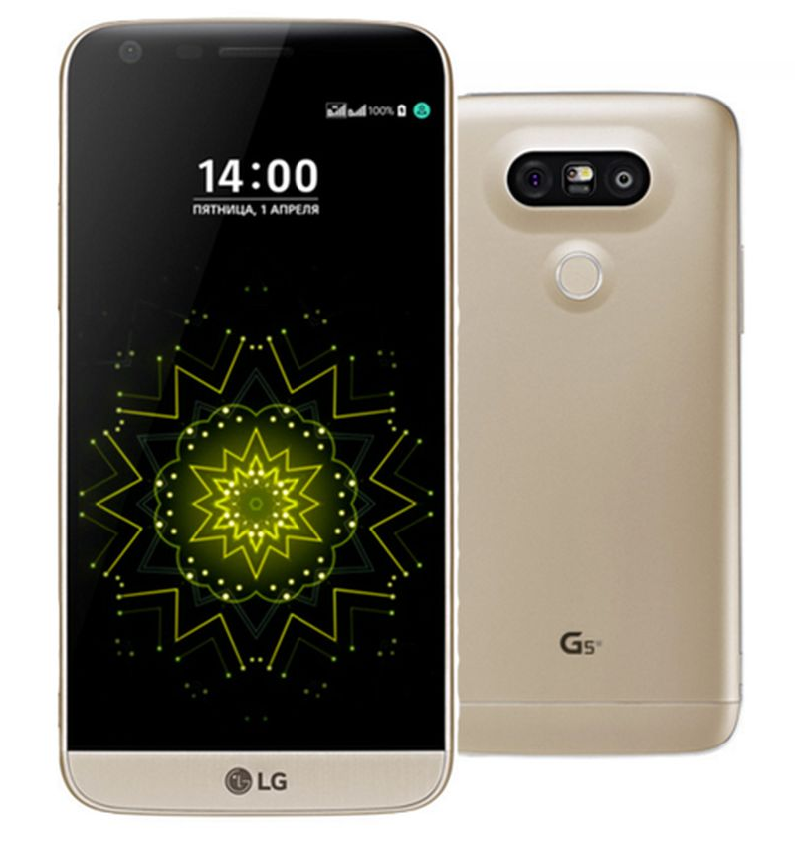
Where is the Camera?
Camera lenses
Application
Notes:
Selfie lens
Everyone else lens
TIP: Keep it clean. Make sure to regularly wipe off your lens to make sure your getting a clear image
Help them find the app on their phone, either on home screen or in the apps. Help them move it for easier access.

Slide 4
PHOTO TIP 1: Make sure that your lens is clean and clear of debris. Glasses cleaner/cloth are great for this.

Slide 5
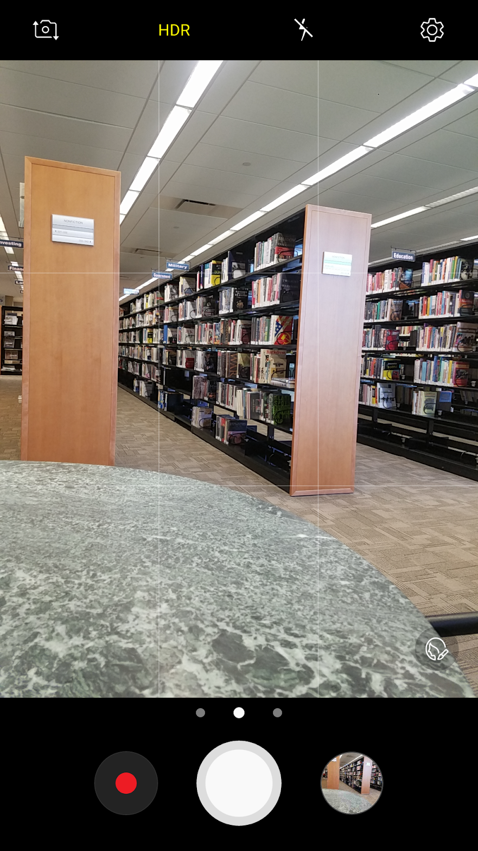
Common View
“Say cheese”

Slide 6
PHOTO TIP 2: Take multiple pictures of the same thing so you have options.

Slide 7
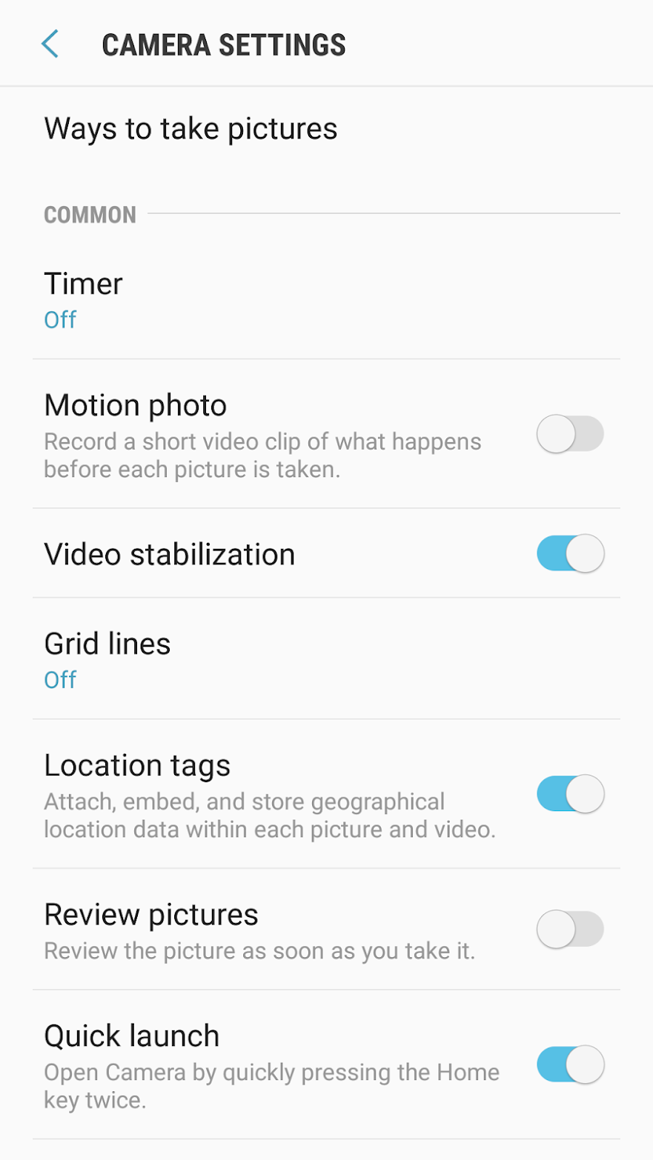
Settings

Slide 8
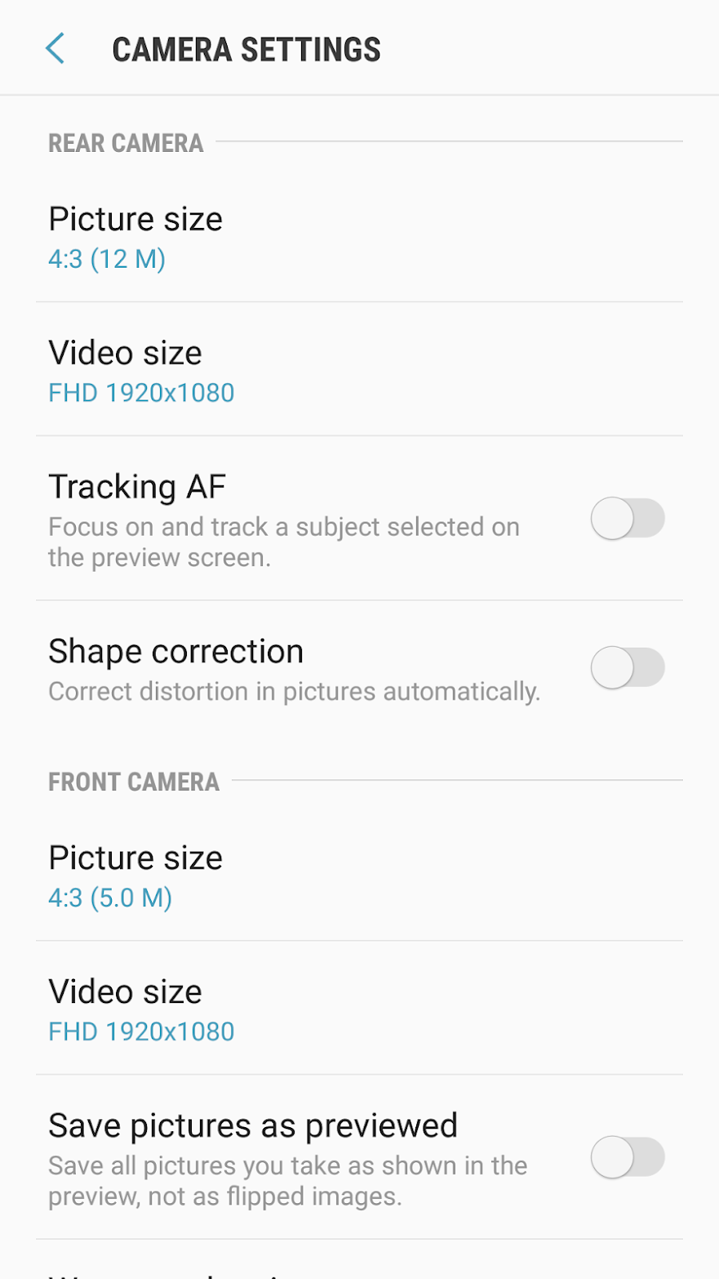
Settings

Slide 9
PHOTO TIP 3: Turn on the gridlines for better composition. Photographers use the “rule of thirds” to help frame their subject and create better photos.

Slide 10
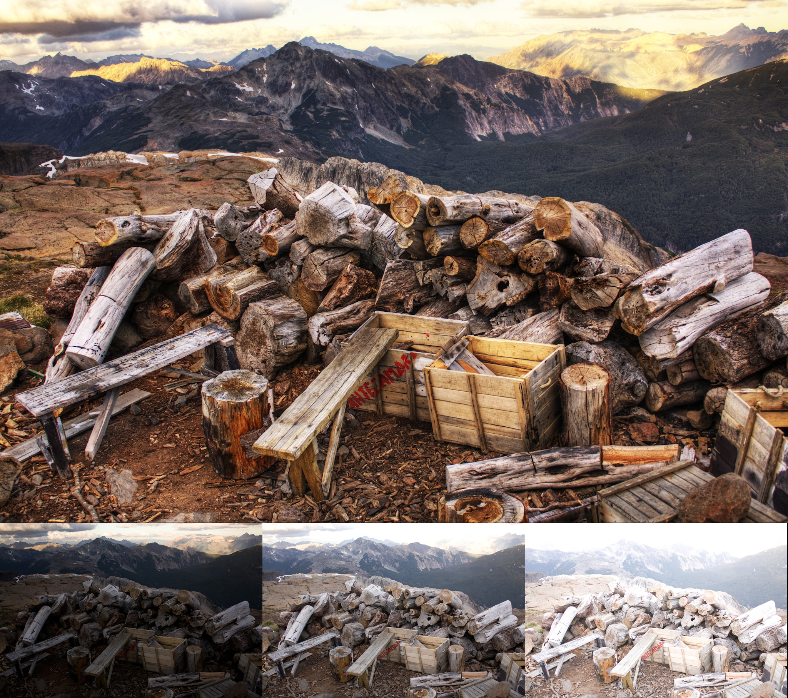
High Dynamic Range
Notes:
HDR, as its name implies, is a method that aims to add more "dynamic range" to photographs, where dynamic range is the ratio of light to dark in a photograph. Instead of just taking one photo, HDR uses three photos, taken at different exposures. You can then use image editing software to put those three images together and highlight the best parts of each photo. In the case of HDR on smartphones, your phone does all the work for you—just snap your picture and it'll spit out one regular photo and one HDR photo. The result is something that should look more like what your eyes see, rather than what your camera sees.

Slide 11
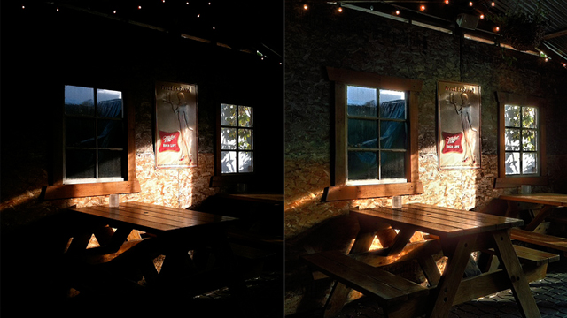
HDR vs. Regular Settings

Slide 12
PHOTO TIP 4: Play with your settings and options to take the best photos in the situation. HDR is great, but not always the best.

Slide 13
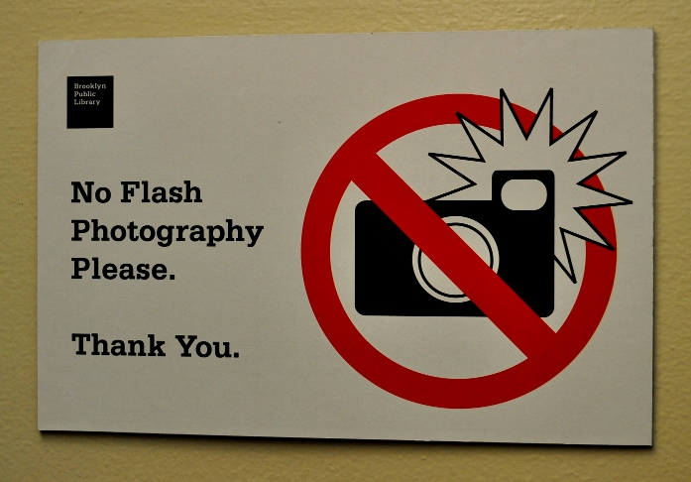
The Flash

Slide 14
PHOTO TIP 3: Lighting makes a difference! Try and use natural lighting if available. The camera’s flash will likely wash out the subject and picture.

Slide 15
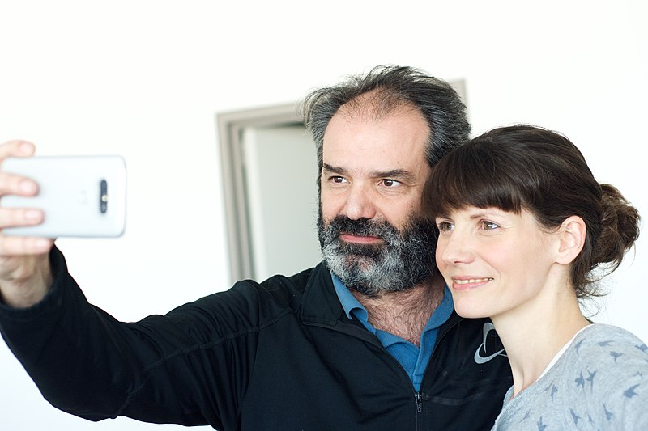
Switch the lens view

Slide 16
Selfie Stick
Additional tool for:
Group pictures
Traveling and capturing background scenery
Don’t have another person to take the picture
Keeps your arm out of selfies

Slide 17
PHOTO TIP 4: Don’t use the zoom. Your lens is not like a standard camera’s lens. The best way to zoom is using your feet.

Slide 18
Additional functions
Gallery
Video

Slide 19
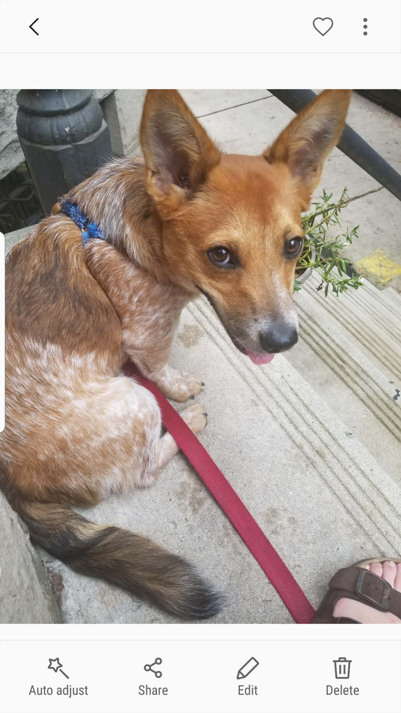
Gallery
Review, edit and share your photos

Slide 20
1. To take pictures (shutter control)
2. Maximize or minimize options
3. Effects
4. HDR switch
5. Self-timer
6. Flash
7. Image Resolution
8. Settings
9. Last Image/Gallery
10. Camera/camcorder Switch
11. Camera Toggle (lens switch)
12. Shooting Mode
2
9
3
10
4
1
5
6
11
7
8
12
Other options – more advanced
Notes:
Settings
Picture size
Flash
Timer
HDR – High dynamic imaging – helps users to reproduce better dynamic range of luminosity than with standard digital one.
Effects – next slide
Arrow hides menu
Mode next slide
Lens select
Capture
Record video
gallery

Slide 21
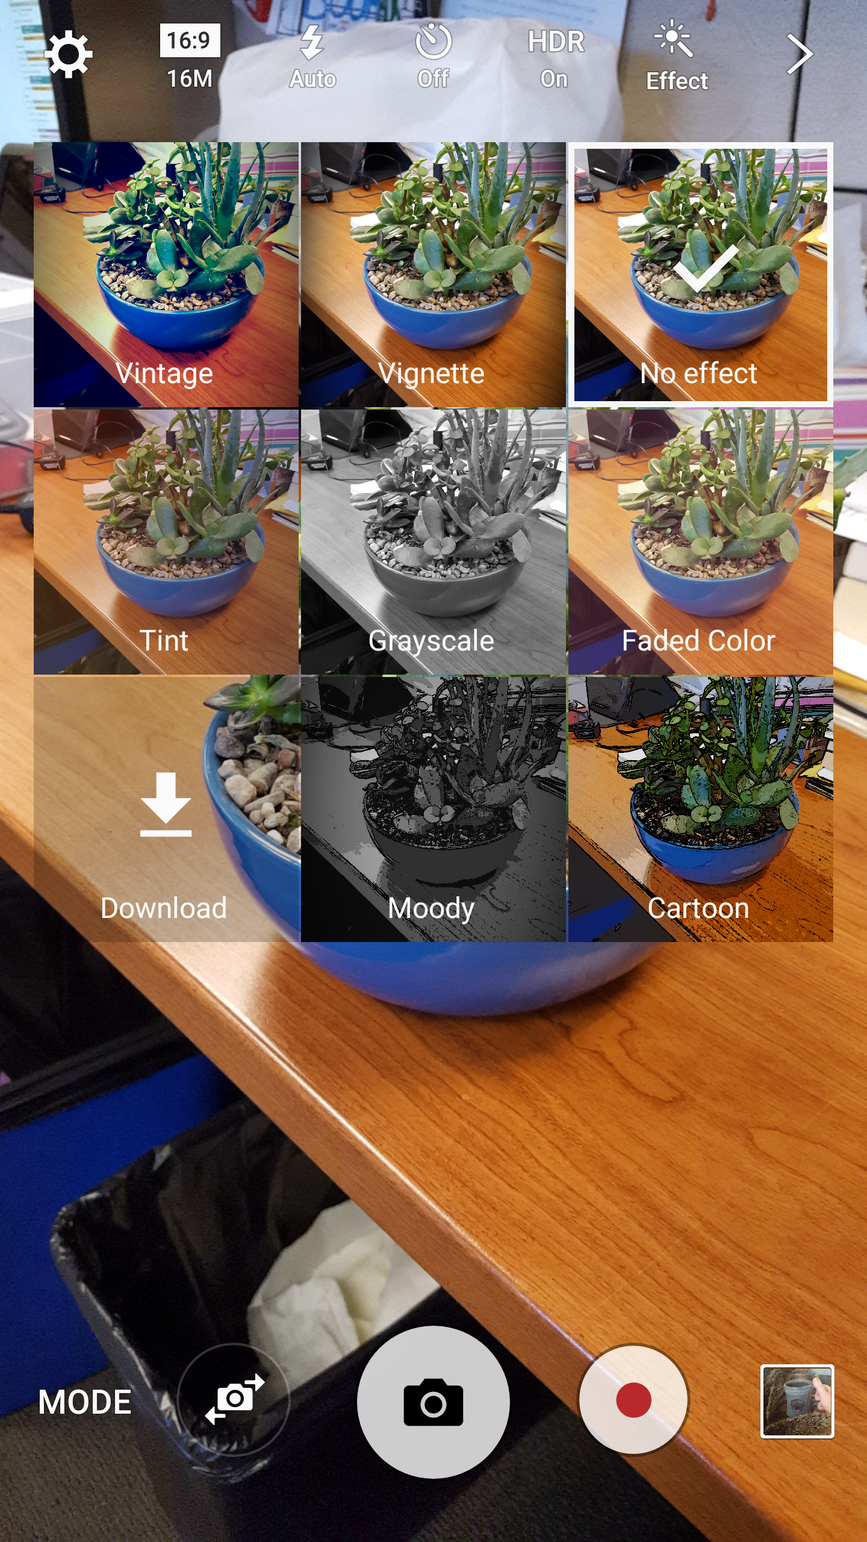
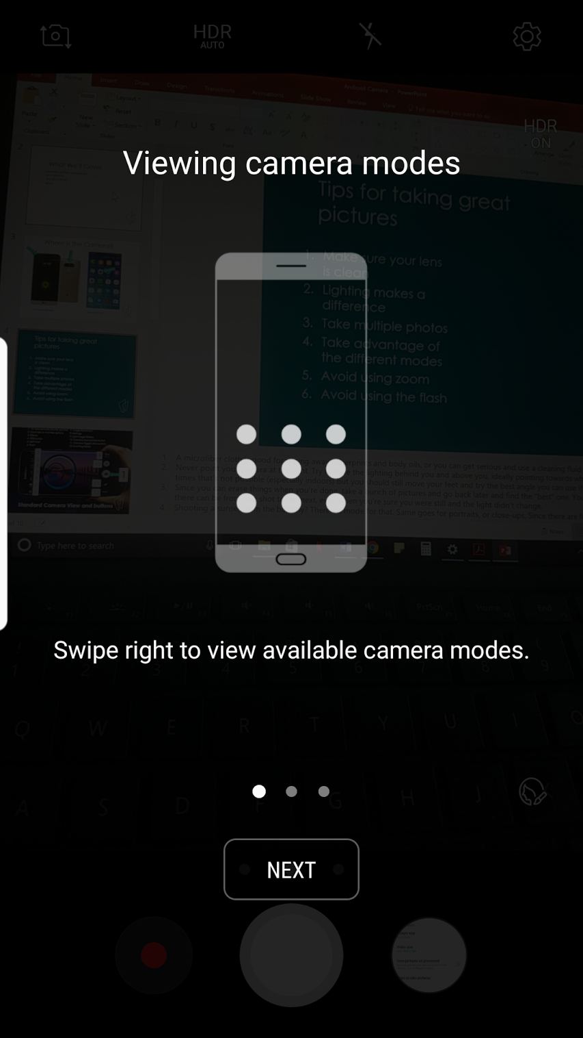
More Advanced Camera Functions
Notes:
Effects – next slide
Basically filters
Mode
Makes it more similar to a manual camera (too advanced for me to cover)

Slide 22
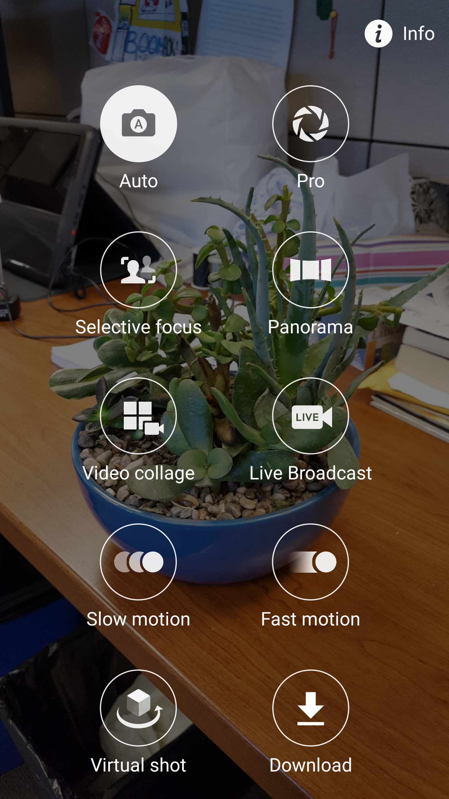
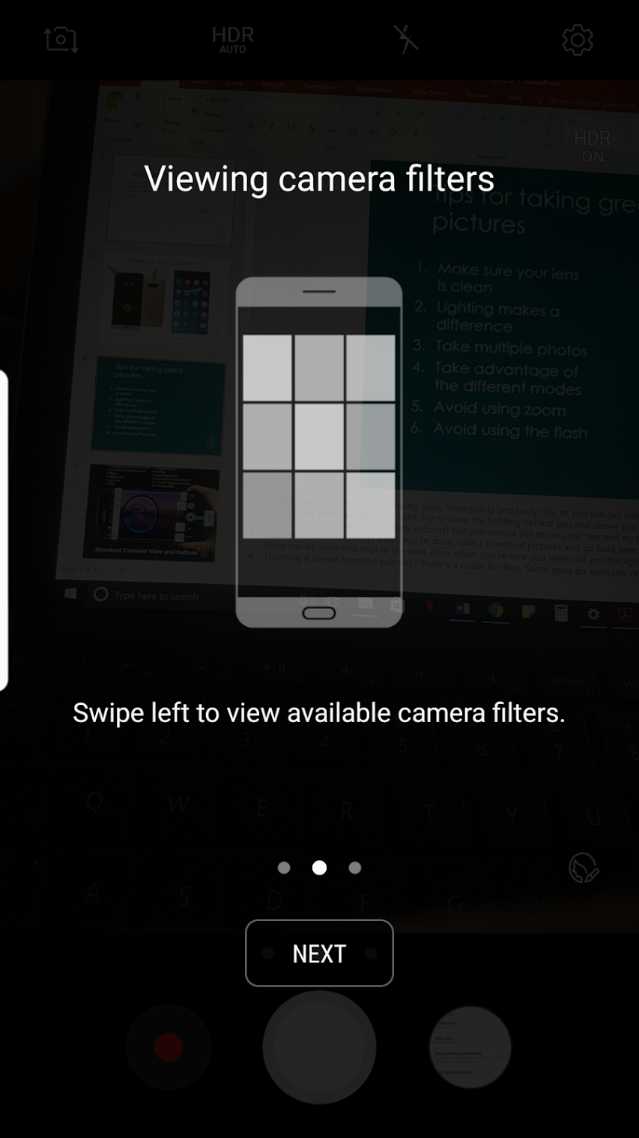
More Advanced Camera Functions
Notes:
Effects – next slide
Basically filters
Mode
Makes it more similar to a manual camera (too advanced for me to cover)

Slide 23
Tips for taking great pictures
Make sure your lens is clean
Lighting makes a difference
Take multiple photos
Take advantage of the different modes
Avoid using zoom
Avoid using the flash
Notes:
A microfiber cloth is good for wiping away fingerprints and body oils, or you can get serious and use a cleaning fluid designed for electronic screens.
Never point your camera at the light. Try to have the lighting behind you and above you, ideally pointing towards whatever it is you're taking a picture of. Often times that's not possible (especially indoors) but you should still move your feet and try the best angle you can use if possible.
Since you can erase things when you're done, take a bunch of pictures and go back later and find the "best" one. You will be surprised how much difference there can be from one shot to the next, even when you're sure you were still and the light didn't change.
Shooting a sunset from the balcony? There's a mode for that. Same goes for portraits, or close-ups. Since there are few (if any) actual moving parts in a smartphone camera, software adjustments are used to make all the difference. Learn the different shooting modes for your phone (and your favorite camera app) and always use the one that suits things the best. If in doubt, Auto is probably your best bet until you learn about using manual controls.
Your smartphone camera has no optical (using the lens) zoom. Instead, when you use the zoom feature, it's doing the same thing as blowing an image up in an editor and cropping out the edge. This generally makes for grainy, pixelated pictures that you won't want to share with anyone. If you need to get a closer view of that thing your photographing, moving closer to it is always better than using your zoom. Always.
The camera flash in our smartphones is getting better, but they are still best left turned off or used for a flashlight. They sit too close to the sensor and create harsh, washed out pictures with vampires in them. Sometimes you have to use it, and sometimes it works fine, but most times you'll not like what you see when you use it.

Slide 24
Apps
Notes:
Gallery – this is where your photos will automatically save to after you take them. This is where you can review or send photos to other people

Slide 25
Thank You
Want a copy of this presentation?
Visit www.skokielibrary.info/handouts
where this presentation will be available
for four weeks.

