Slide 1
Bitcoin and Cryptocurrency
By Ethan Herdrich
Experiential Learning Specialist

Slide 2
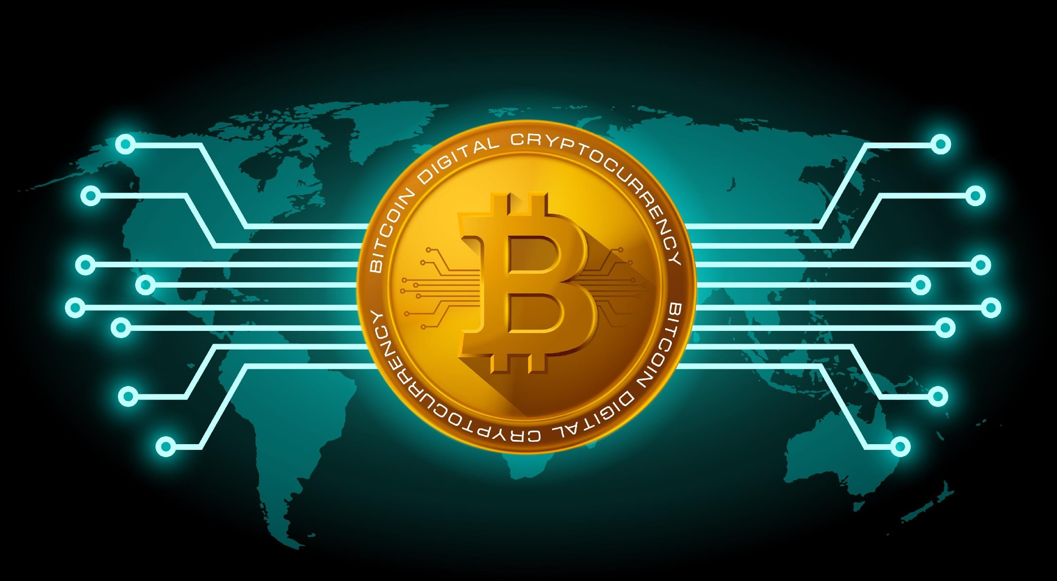

Slide 3
What is Bitcoin?
Well it is two things.

Slide 4
Bitcoin the Token
The digital currency itself
a snippet of code that represents ownership of a digital concept

Slide 5
Bitcoin the Protocol
a distributed network that maintains a ledger of balances of bitcoin-the-token.
Otherwise known as the Block Chain

Slide 6
The Block Chain
A publicly accessible Ledger
Ordered chronologically in blocks
Unchangeable
Verified by a decentralized network of miners

Slide 7
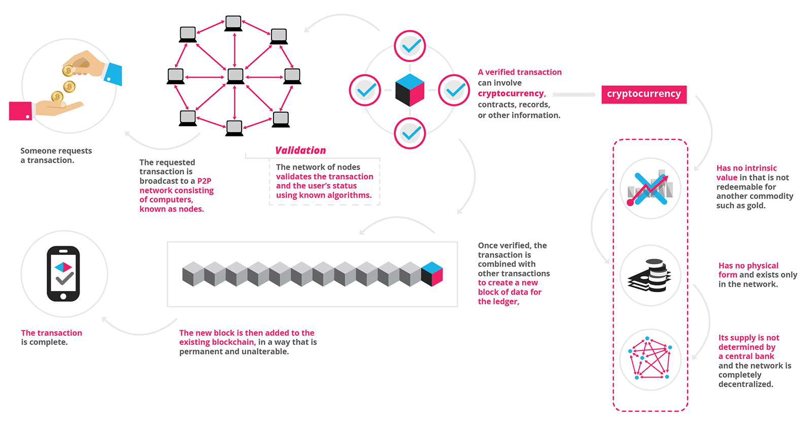
Block Chain

Slide 8
Mining
Verifying Transactions
By solving computational puzzles
Miners compete to win Bitcoin similar to a lottery
Awarded transaction fees as well as new bitcoin
High overhead with power consumption
Uses high end GPUs
Has lead to a Graphics Card Shortage
Mining Infographic

Slide 9
Origins and the Deep Web
created in 2009 by an unknown person using the alias Satoshi Nakamoto
Silk Road launches in 2011, uses bitcoin as it’s currency, as bitcoin can be pseudo-anonymous

Slide 10
I thought it was anonymous?
No personal info is required to use bitcoin
Transactions are verified by the network, making it hard to trace
However the block chain is a permanent and public ledger
The easiest way to buy and sell requires bank account info

Slide 11
Other Cryptocurrencies
Lite Coin
Bitcoin Cash
Ethereum
Atari Token
Zcash
Dash

Slide 12
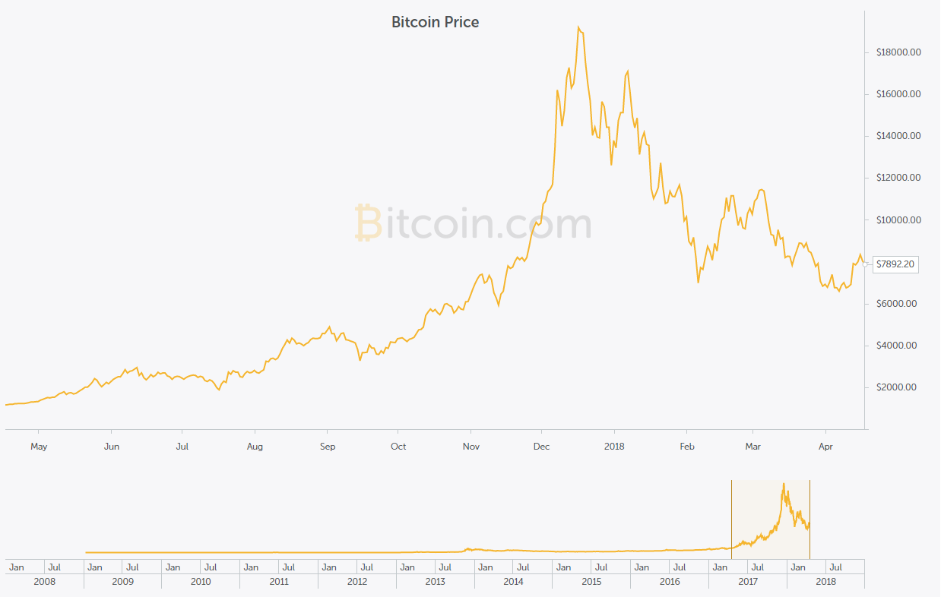
Volatility

Slide 13
Buying and Selling
Requires a Bitcoin Wallet
Many wallets are tied to an Exchange
Coinbase is the leading Exchange
Buy and Sell based on the current exchange value

Slide 14
Paying with Bitcoin
Overstock.com
Expedia
eGifter
Newegg
Dish Network
Intuit, a paywithbitcoin service for small businesses
Microsoft
Reeds Jewelers
Green Man Gaming Accepts Bitcoins As Payment? List of Companies | 99Bitcoins

Slide 15
Thank You
Want a copy of this presentation?
Visit www.skokielibrary.info/handouts
where this presentation will be available
for four weeks.

