Slide 1
How to Avoid Internet Trolls and Troublemakers
and find credible information
Lynnanne Pearson
Adult Services Manager

Slide 2
What we will learn:
History of fake news and what is journalism
How to evaluate a story
How to avoid those trying to trick you
Tech tools to use
Finding unbiased and multiple viewpoints on an issue

Slide 3
Resources to consult
Librarians at the Reference Desk
1 on 1 consultations with a librarian
News Articles Databases https://skokielibrary.info/resources/research/articles/
Civic Lab https://skokielibrary.info/resources/civic-lab/

Slide 4
Books to Read
The Truth Matters: A Citizen's Guide to Separating Facts From Lies and Stopping Fake News in Its Tracks by Bruce Bartlett
The News: A User's Manual by Alain De Botton
The Influencing Machine: Brooke Gladstone on the Media by Brooke Gladstone, illustrated by Josh Neufeld
Broadcast Hysteria: Orson Welles's War of the Worlds and the Art of Fake News by A. Brad Schwartz

Slide 5
Fake News: A history lesson

Slide 6
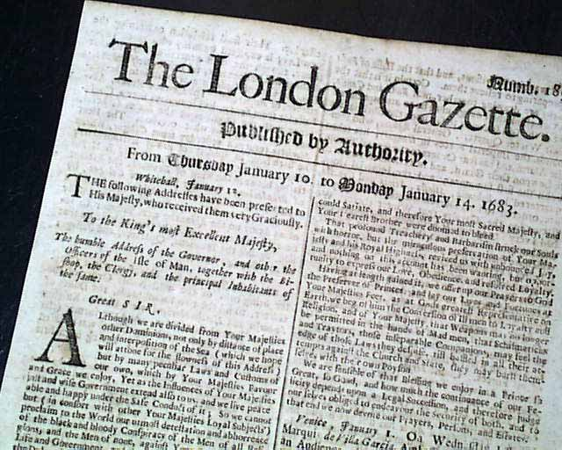
Fake news is older than you think
http://www.rarenewspapers.com

Slide 7
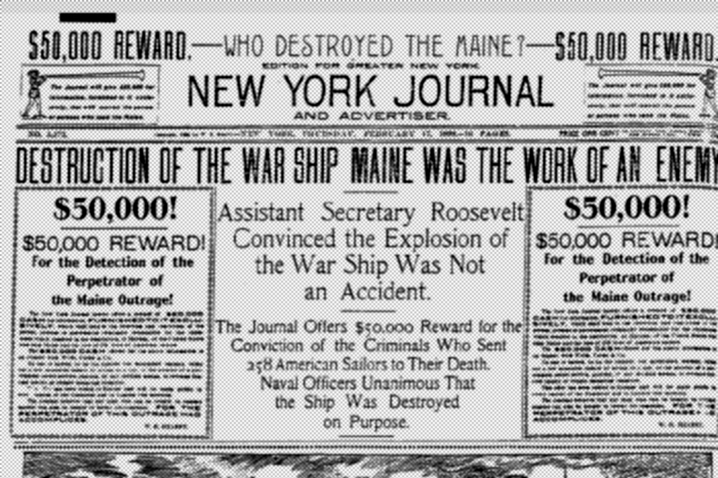
“You furnish the pictures,
and I’ll furnish the war.”
via Wikimedia Commons

Slide 8
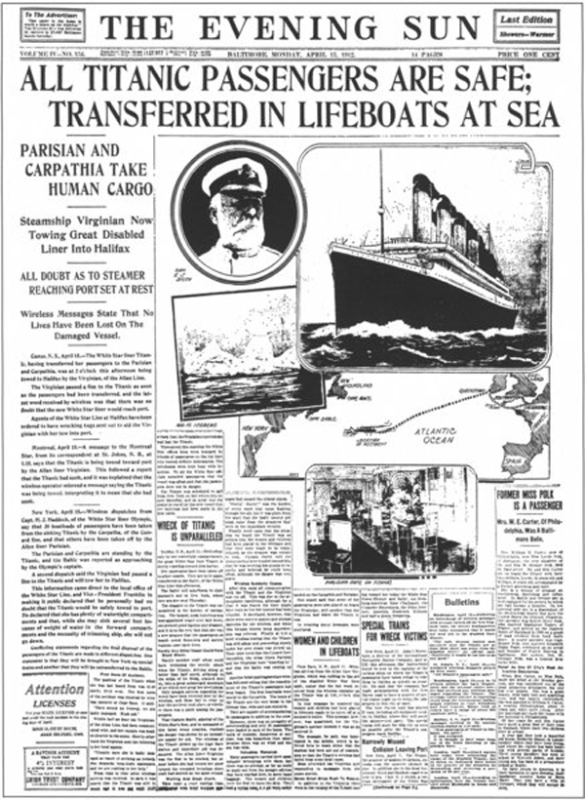
The Baltimore Sun

Slide 9
Sound familiar?
“Some historians also have noted that yellow journalism features poorly researched stories, anonymous sources, sometimes sympathy for or exploitation of the underdog and often self promotion for the writer and/or news outlet.”
Norma Green
Columbia College Professor and Journalism Historian

Slide 10
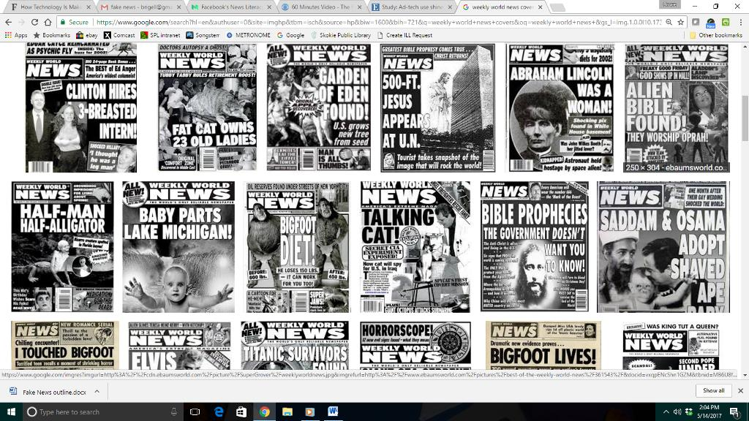
Sometimes the fake news is amusing

Slide 11
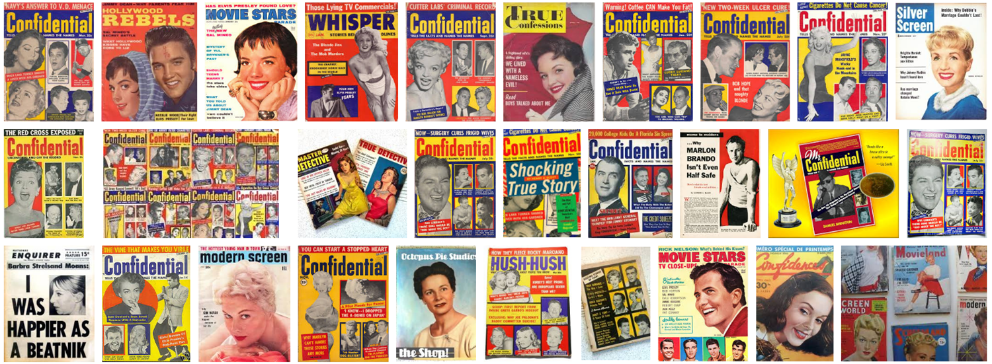
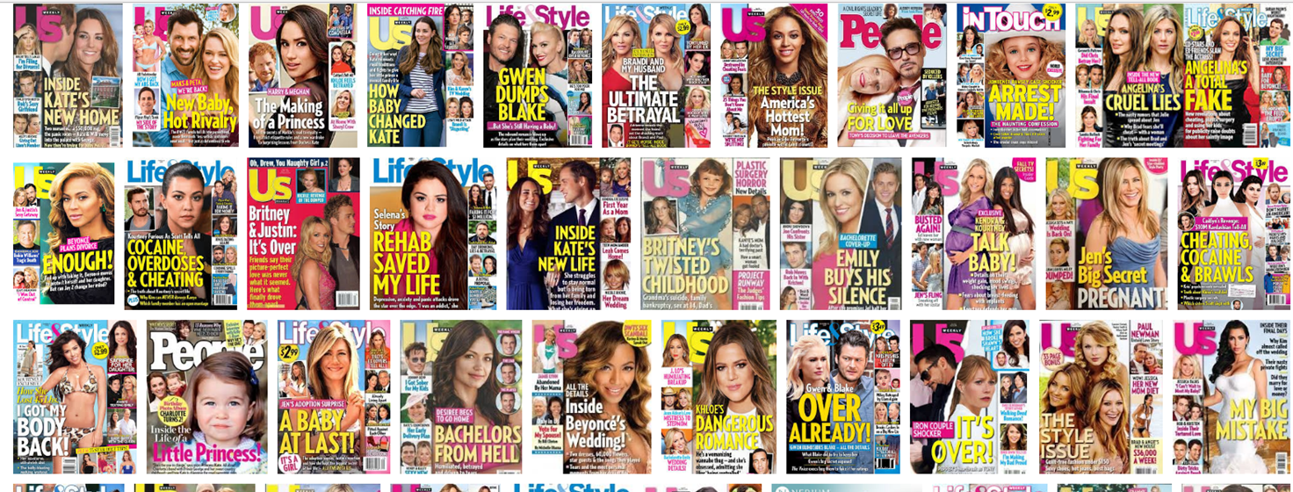
Or about celebrities

Slide 12
Why do people publish fake news?
To change public opinion
Money
  Ad revenue. The more clicks you get, the more money you make
  Scams
Because of their personal or organizational bias
  Even if it’s not true, it sounds like it could be true
Rush to be first
  In wanting to be the first to report a story, news outlets may fail to practice due diligence and further research the claims and facts of the story

Slide 13
So how do you avoid internet trolls and troublemakers?

Slide 14
Journalism and the news

Slide 15
News Values
aka why a story is reported:
Frequency
Sex
Health
Money
Solution journalism
Danger
Prominence
Proximity
Conflict
Sentiment
Change
Casualties

Slide 16
V.I.A.
V = Verification
I = Independence
A = Accountability
News lives at the intersection of these three. Information can be categorized using these three characteristics.

Slide 17
Breaking news is chaotic
Truth is a statement of probability proportional to the evidence
Truth is provisional and can be overridden by tomorrow’s discovery
Truth won’t stand still. We have to seek it out and it is always morphing
Some (with financial or other interests) try to get in the way of the truth or getting information out
Some will willingly spread misinformation
Notes:
Truth is a statement of probability proportional to the evidence
It may change as the evidence accumulates and reveals new insights
World is flat, can fall off end- until someone came back
Truth is provisional and can be overridden by tomorrow’s discovery
Pluto- no longer a real planet (dwarf planet)
Need to follow the story over time.
With holes in story, people will fill in the holes with their own theories
Why so hard for journalists to get the truth ?
Truth won’t stand still- have to seek it out and it is always morphing
Some try to get in the way of the truth or getting information out
Some will willingly spread misinformation
Breaking news is chaotic

Slide 18
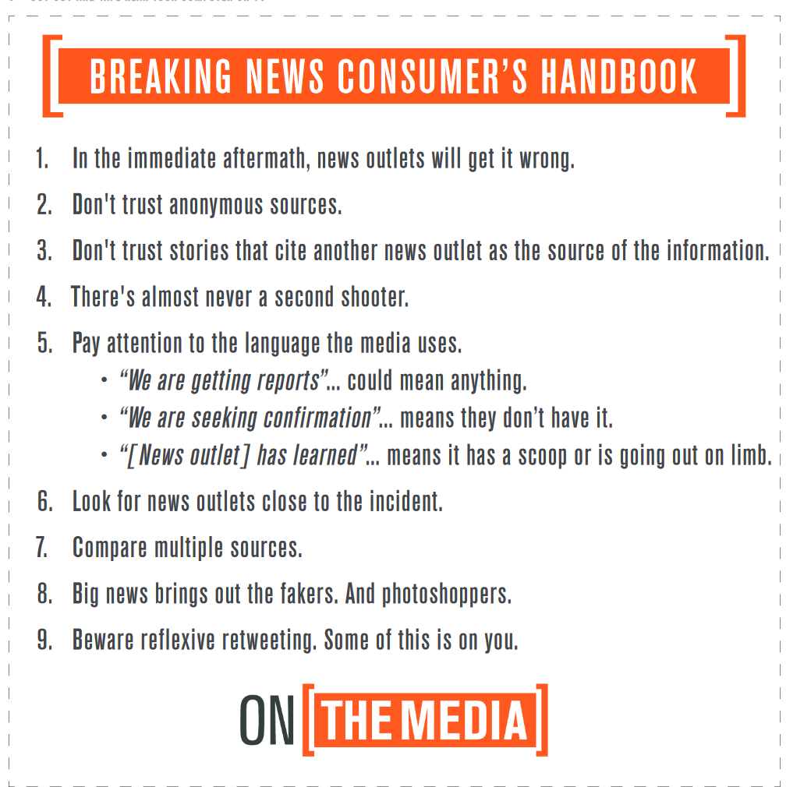
The Breaking News Consumer's Handbook WNYC On the Media Blog https://www.wnyc.org/story/breaking-news-consumers-handbook-pdf/
Notes:
Qualify this as “breaking news”

Slide 19
How to quickly evaluate a story
Evaluate the Headline
Evaluate the site
Skim the story

Slide 20
Headlines
Look out for…
Font size
ALL CAPS
Judgement words and insults
Sensational words and phrases
  Shocking News
  What “THEY” won’t tell you/aren’t telling you
  Watch now before it’s too late
Too good to be true promises

Slide 21
Easy things to evaluate
Have you heard of the website?
What is the URL?
Are there other outlandish sounding stories on their site?
Does the story have a date on it?
Can you contact the author of the story? Is there one?
Are the photos accredited to someone?
Does the story read like the author’s spellcheck is broken?
Does the author cite their source or sources?

Slide 22
Digging Deeper
Are other sites reporting the story?
Can you contact the people behind the site?
Can you look up independently the studies or information they cite?
Can you verify the story or the facts cites using a fact checking site?

Slide 23
When in doubt…
Click off that story
Verify the story using a fact checking site
Check what other sources are saying
Read the original study/poll cited in the story
Check the cited expert’s expertise

Slide 24
Technology tools to help

Slide 25
Browser extensions
AdDetector
  https://goo.gl/V77t0f
B.S. Detector
  https://goo.gl/vZdups
FiB
  https://goo.gl/Xjsyem
Media Bias/Fact Check Icon
  https://goo.gl/dnGhs2
Who Runs This
  https://goo.gl/PWZXBG

Slide 26
Fact checking sites
The International Fact-Checking Network from Poynter Institute
Snopes
PolitiFact
FactCheck.org
Fact Checker from Washington Post
NPR Politics: Fact Check

Slide 27
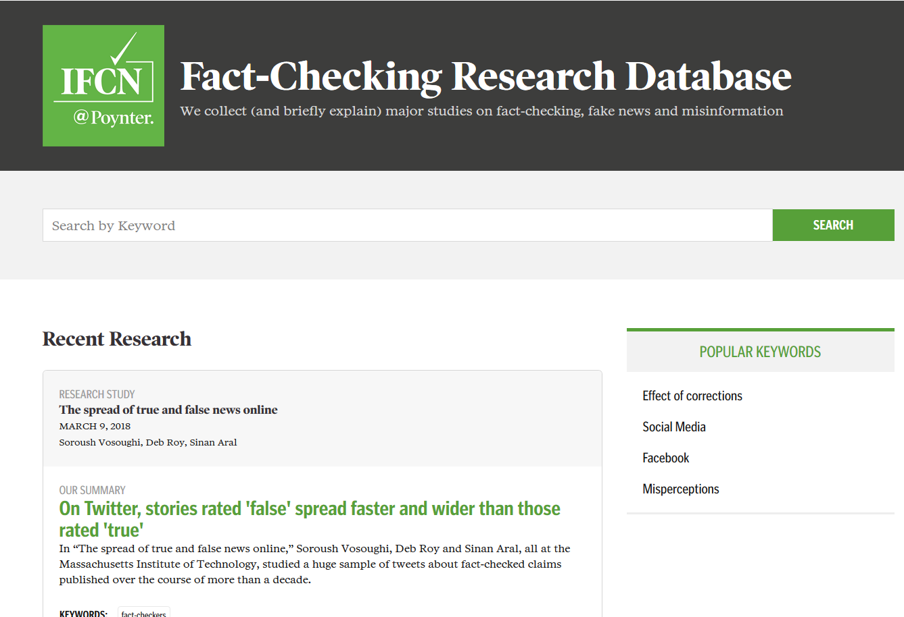
The International Fact-Checking Network from Poynter Institute

Slide 28
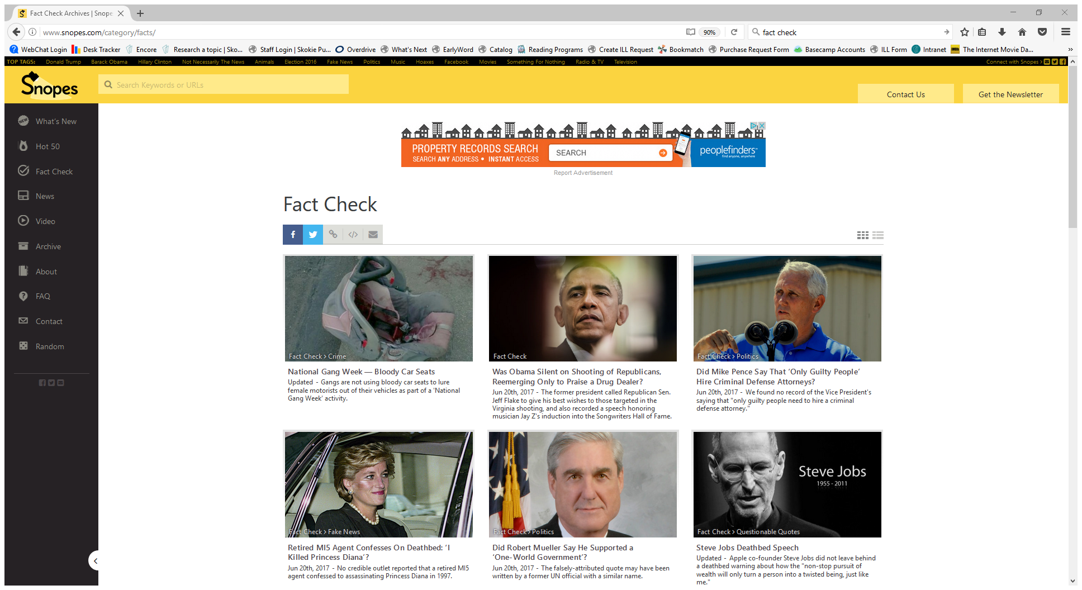

Slide 29
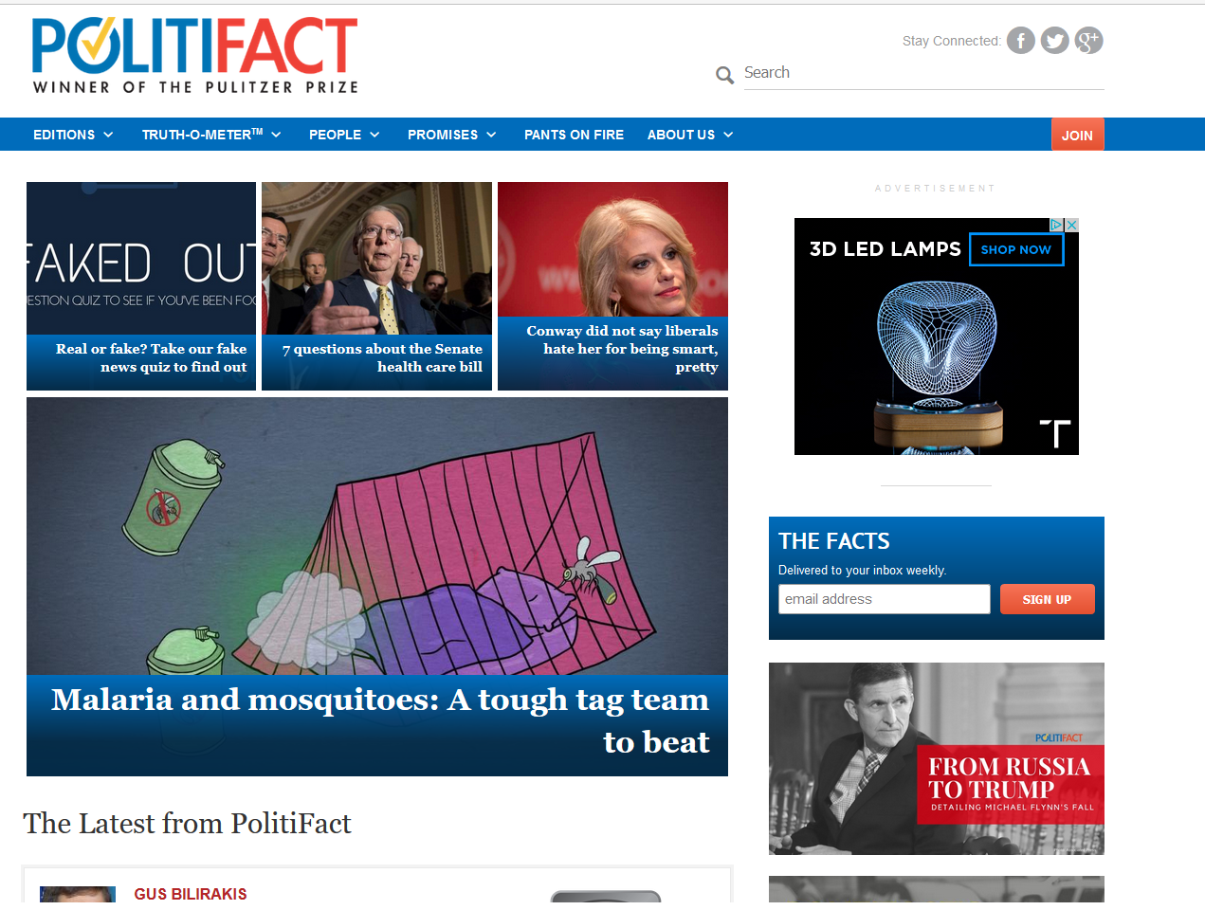

Slide 30
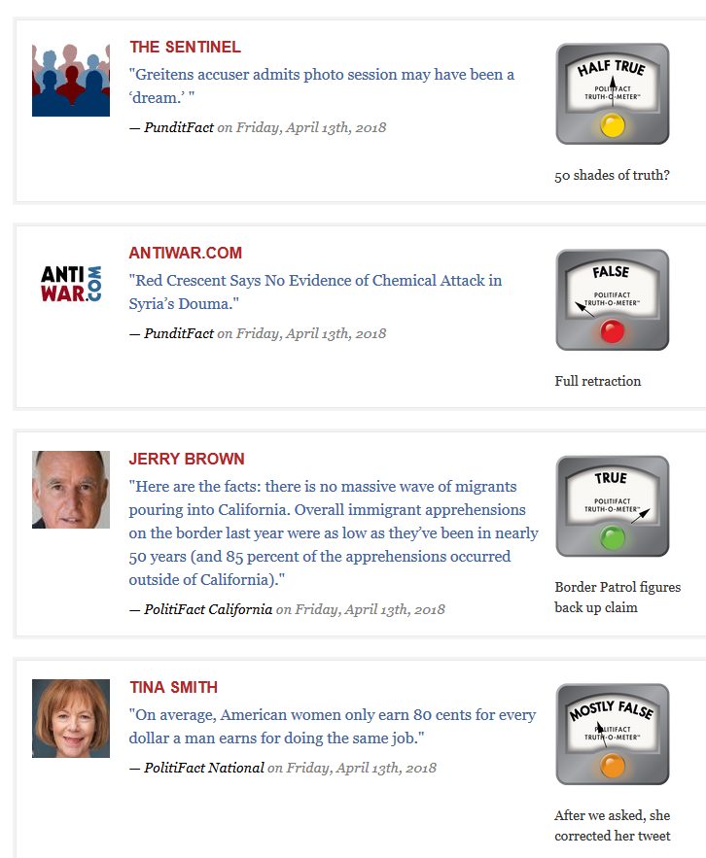
PolitiFact Truth-O-Meter

Slide 31
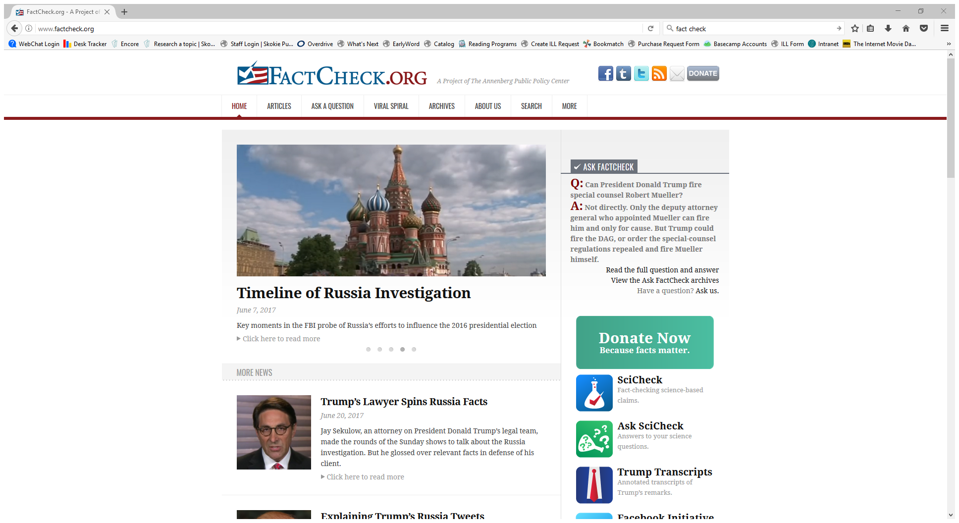
Fact Check
Notes:
We are a nonpartisan, nonprofit “consumer advocate” for voters that aims to reduce the level of deception and confusion in U.S. politics. We monitor the factual accuracy of what is said by major U.S. political players in the form of TV ads, debates, speeches, interviews and news releases. Our goal is to apply the best practices of both journalism and scholarship, and to increase public knowledge and understanding.
FactCheck.org is a project of the Annenberg Public Policy Center of the University of Pennsylvania. The APPC was established by publisher and philanthropist Walter Annenberg to create a community of scholars within the University of Pennsylvania that would address public policy issues at the local, state and federal levels.

Slide 32
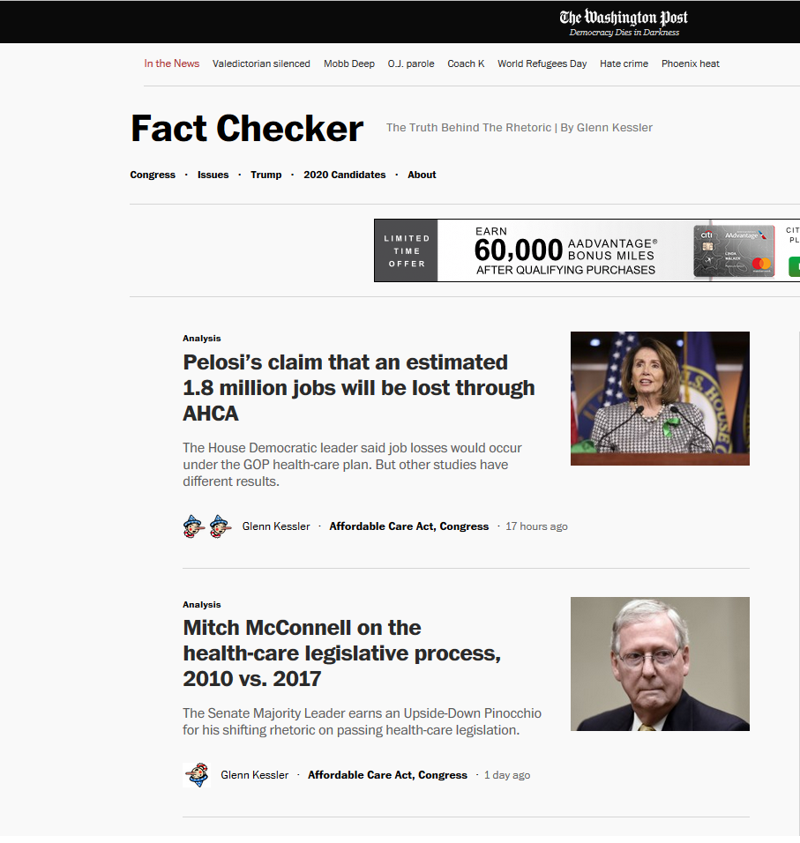
Fact Checker from Washington Post
Notes:
What the ratings mean https://www.washingtonpost.com/news/fact-checker/about-the-fact-checker/?utm_term=.5df1b256b4b8

Slide 33
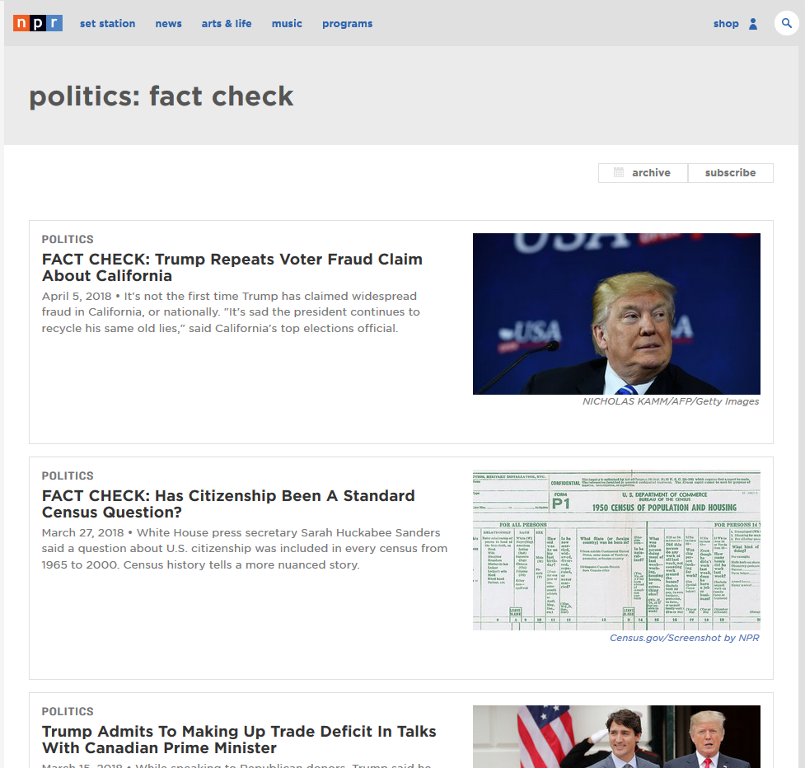
NPR Politics: Fact Check https://www.npr.org/sections/politics-fact-check

Slide 34
Multiple Viewpoints

Slide 35
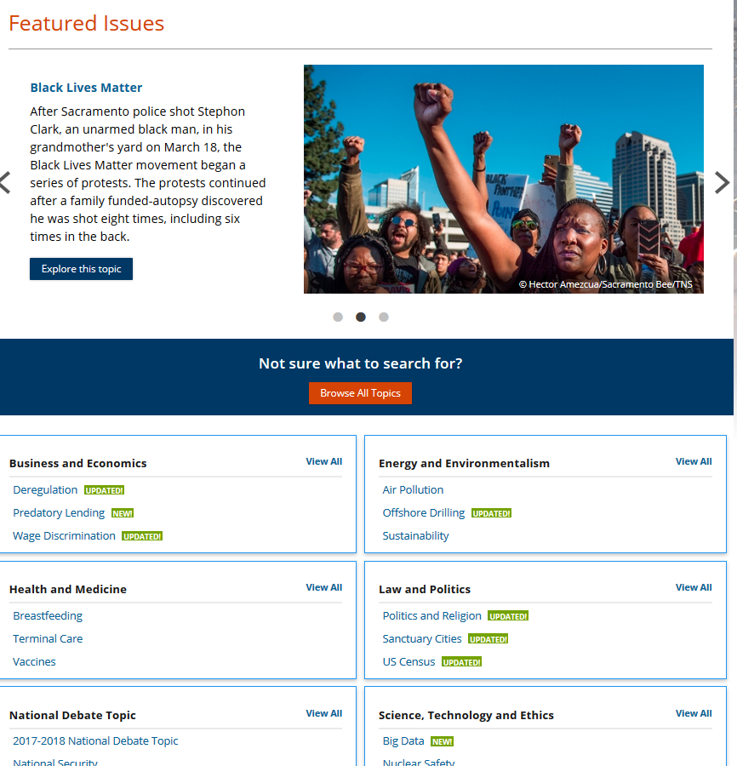
Opposing Viewpoints

Slide 36

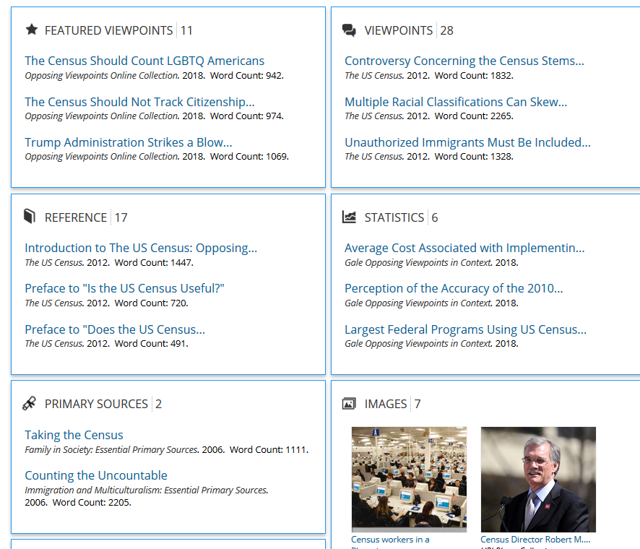
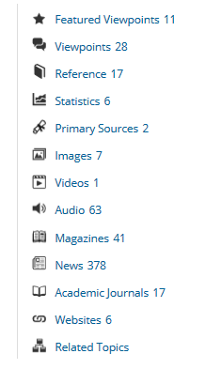

Slide 37
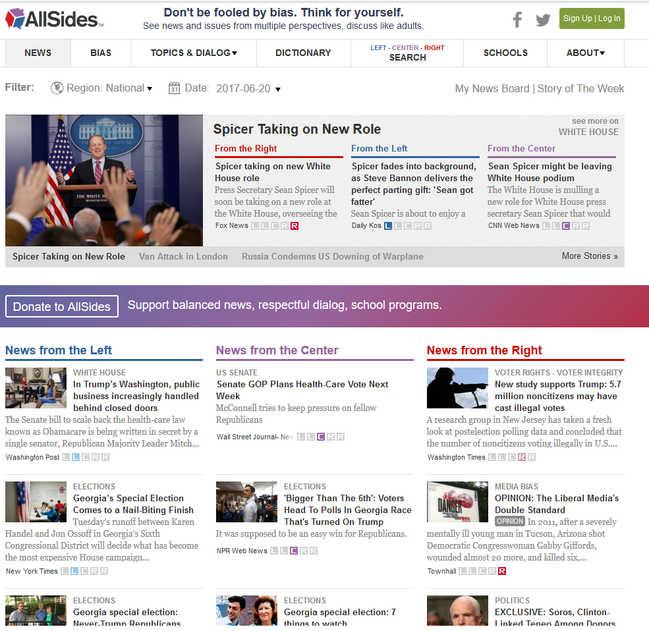
AllSides

Slide 38
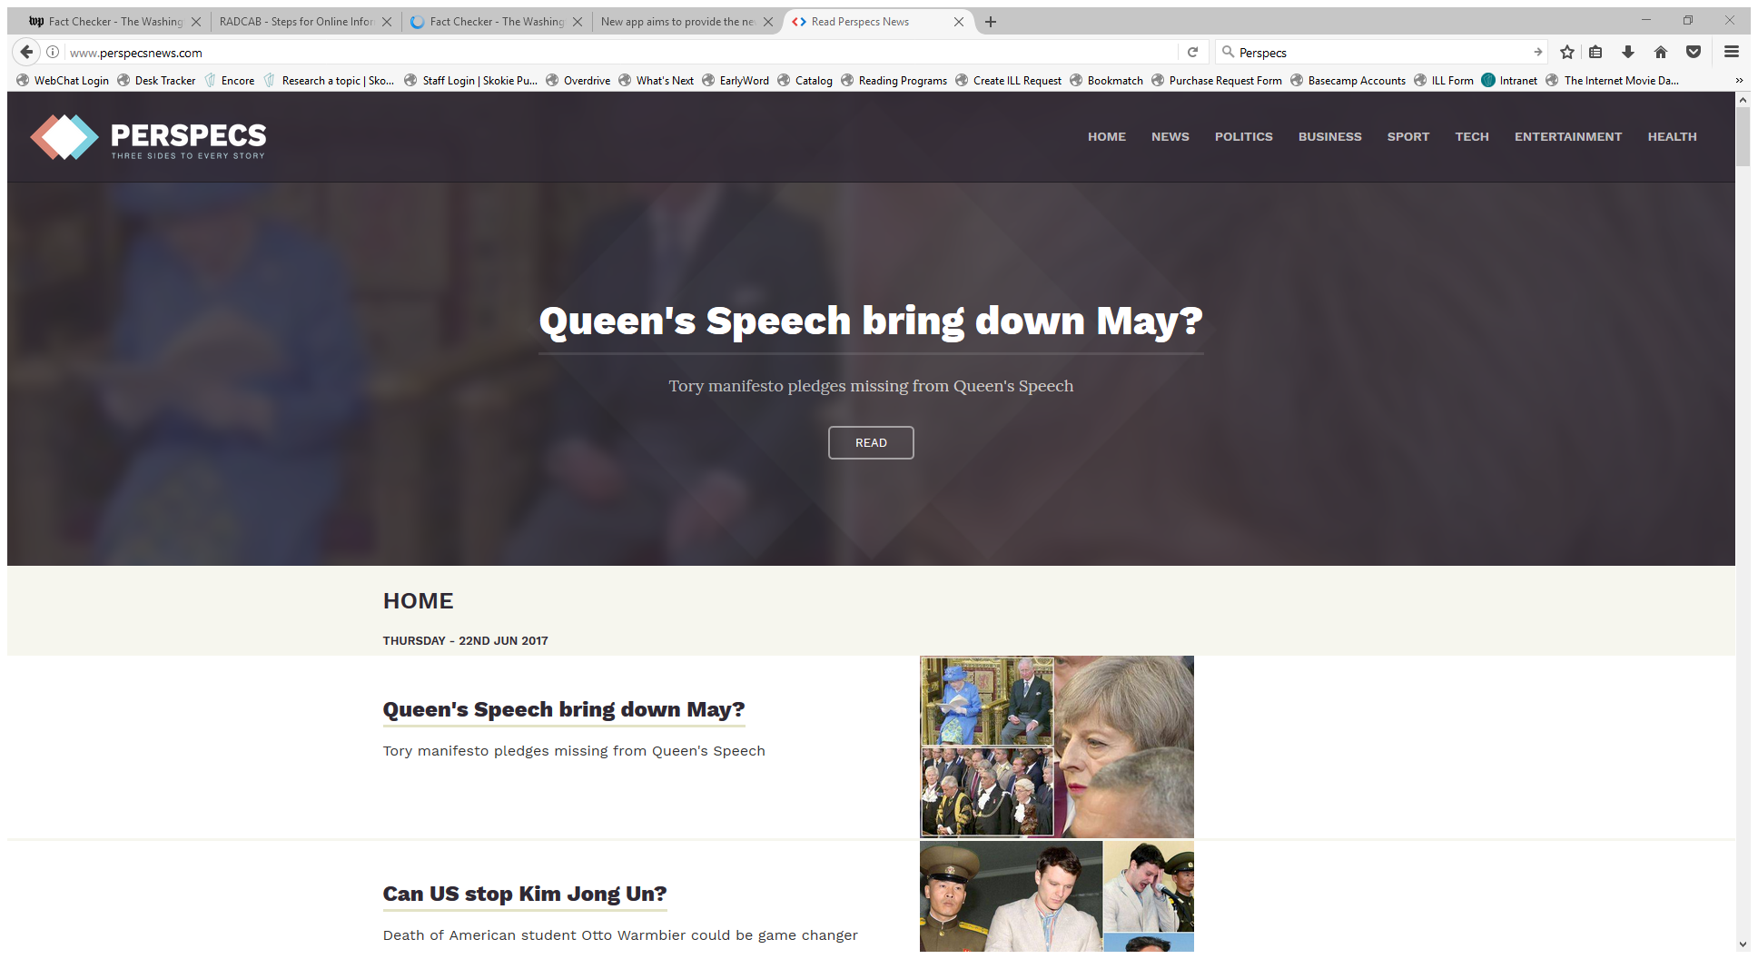
Perspecs

Slide 39
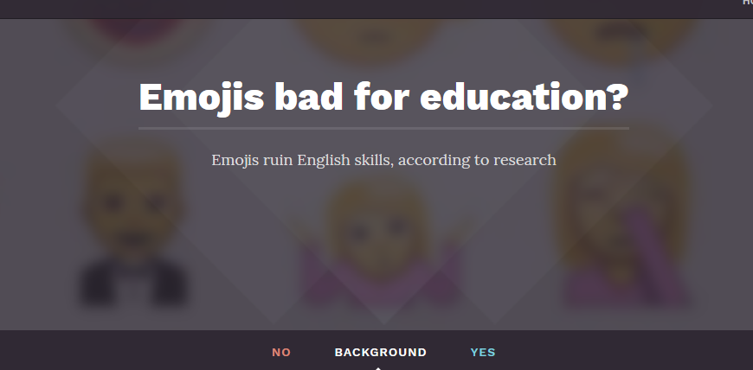

Slide 40
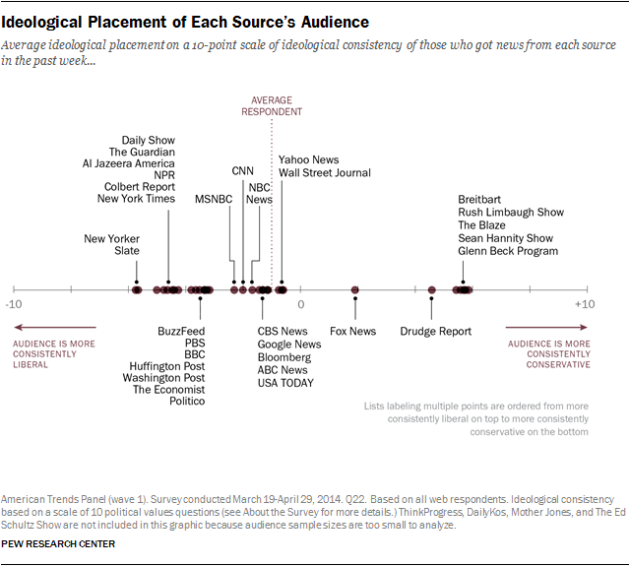
Pew Report
http://www.journalism.org/2014/10/21/political-polarization-media-habits/

Slide 41
Watch out for

Slide 42
Entertainment sites
and
Satirical News

Slide 43
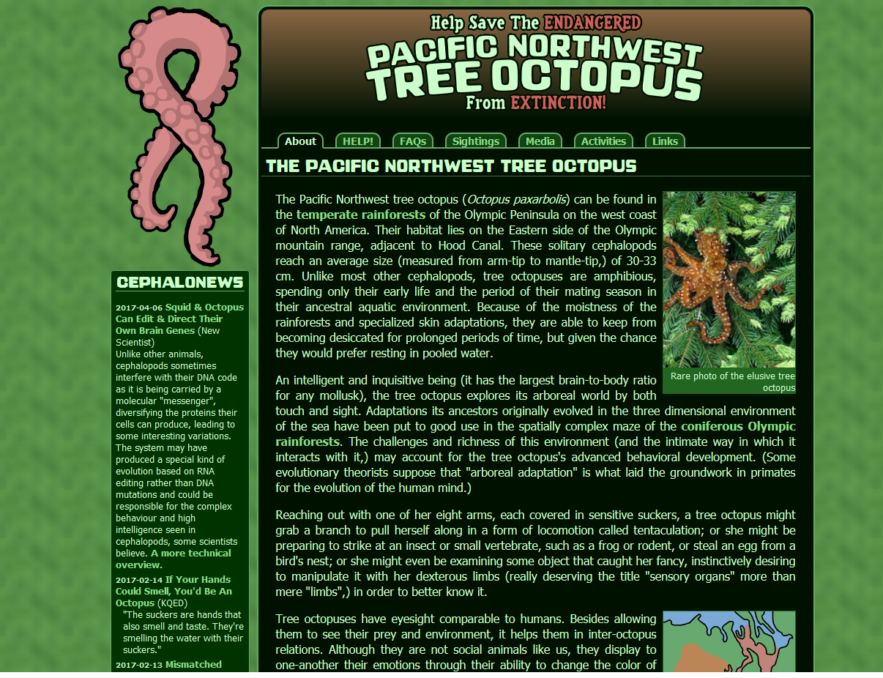
http://zapatopi.net/treeoctopus

Slide 44
Clues that the Pacific Northwest Tree Octopus is not real
Because octopuses are ocean creatures
Tongue in cheek tone of the site (especially the FAQs)
“Sighting” pictures

Slide 45
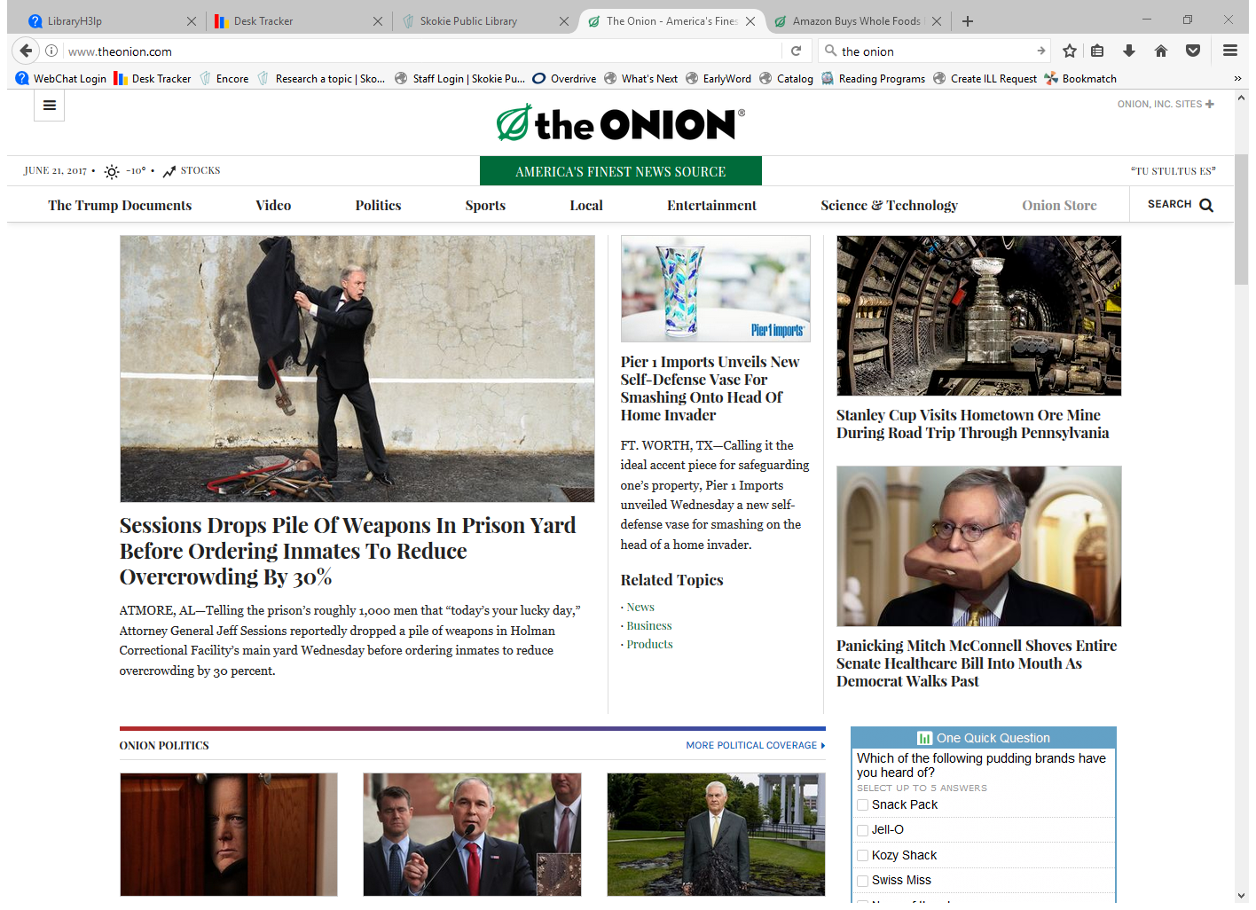
The Onion

Slide 46
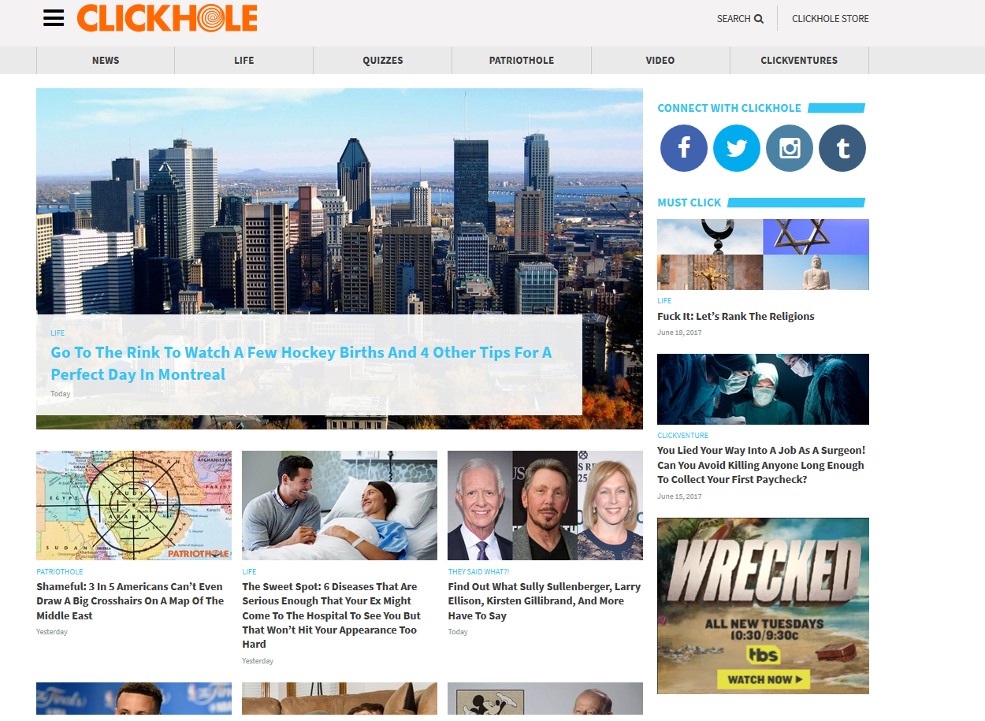

Slide 47
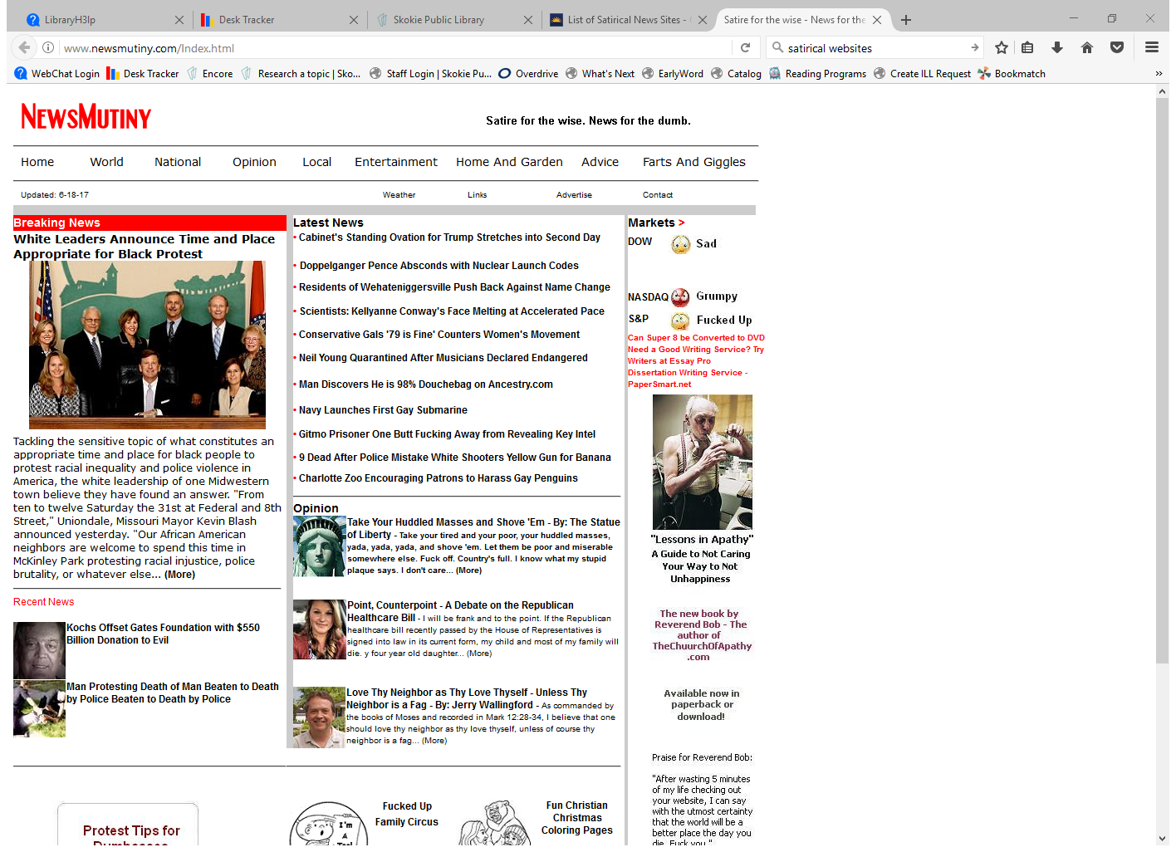

Slide 48
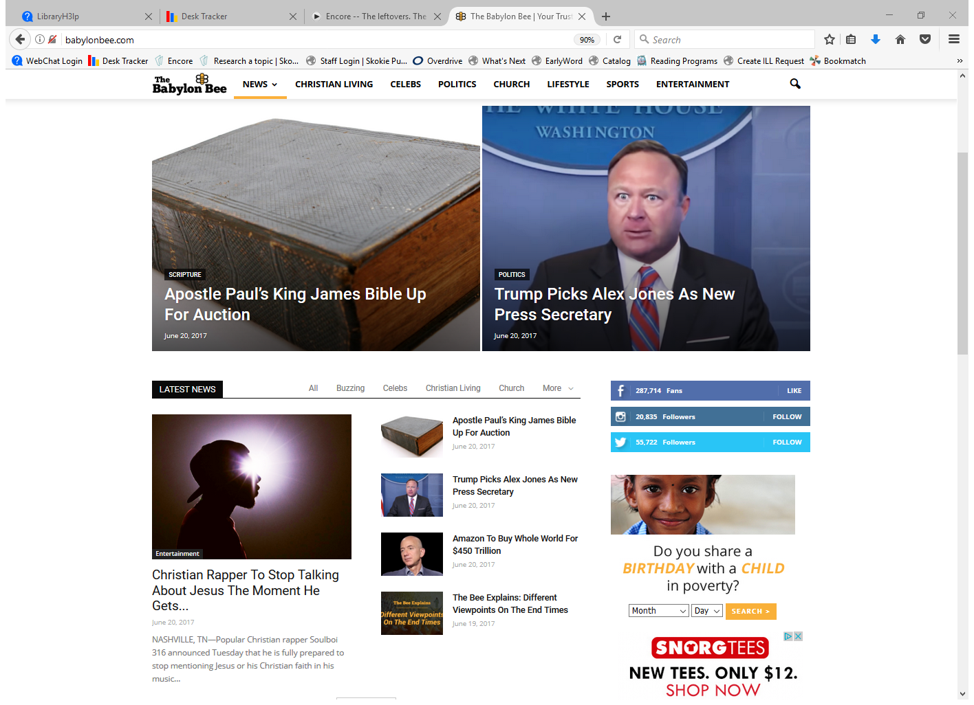
The Babylon Bee

Slide 49
Clickbait

Slide 50
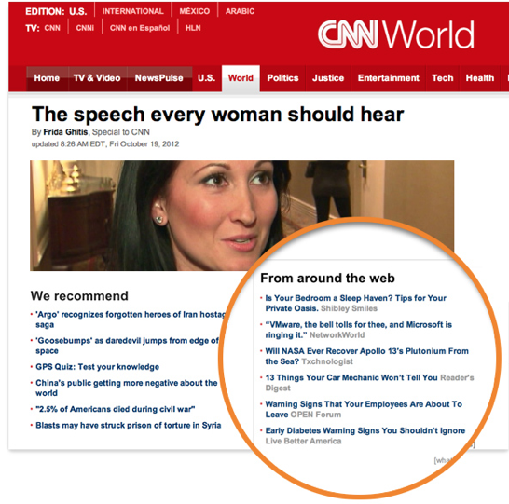

Slide 51
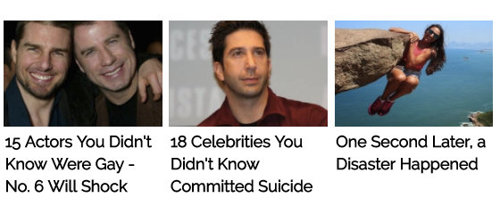
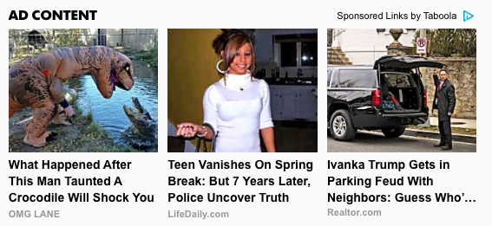
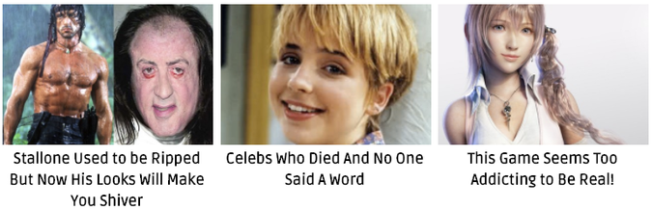

Slide 52
Ads, Advertorials and Native advertising

Slide 53
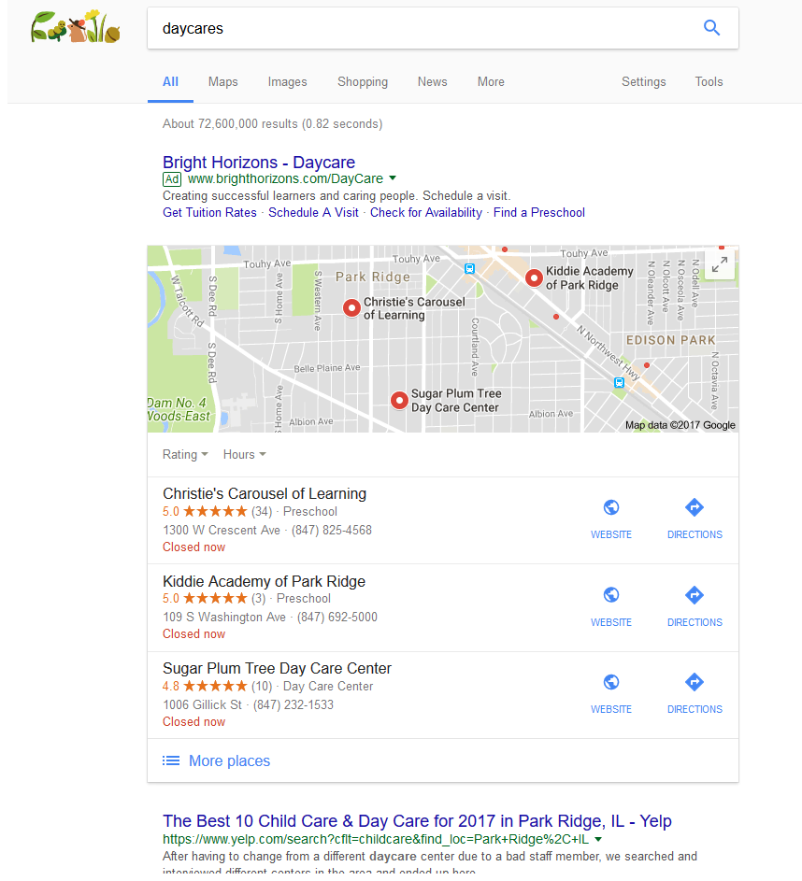
Ads

Slide 54
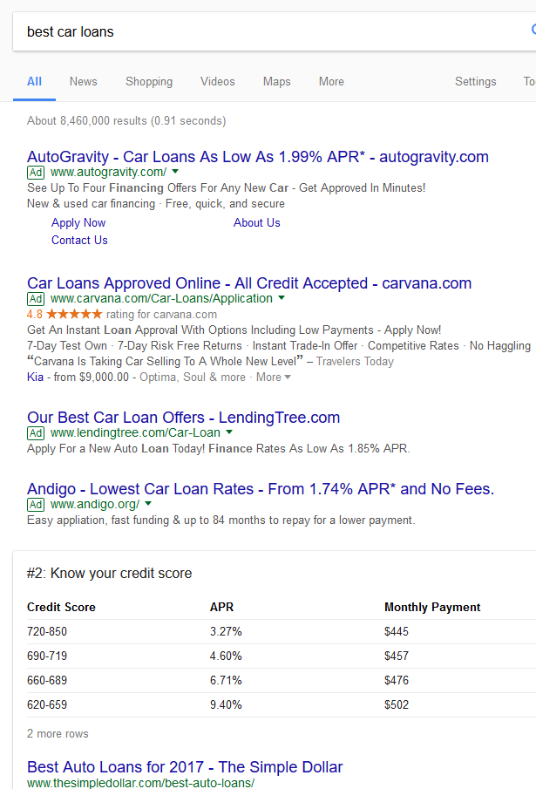
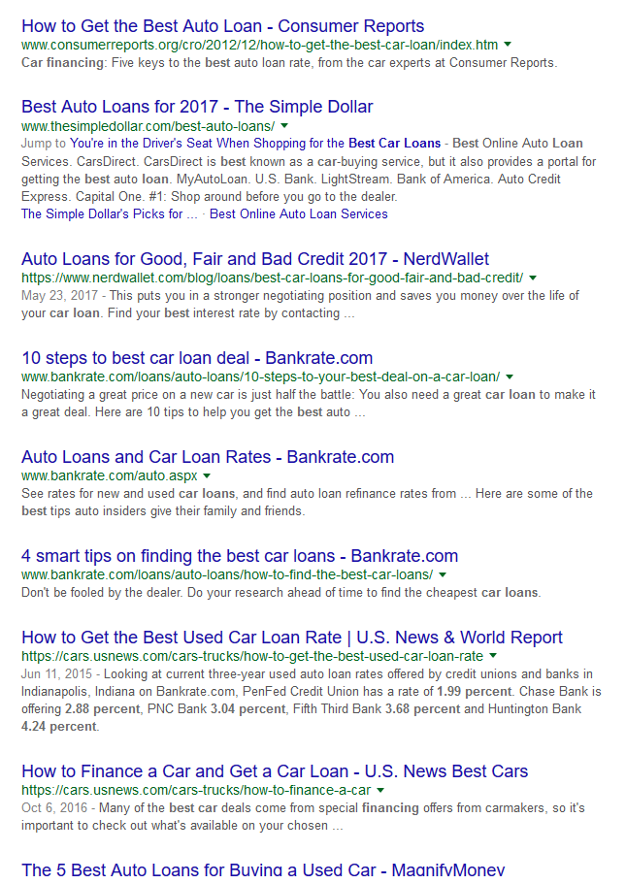

Slide 55
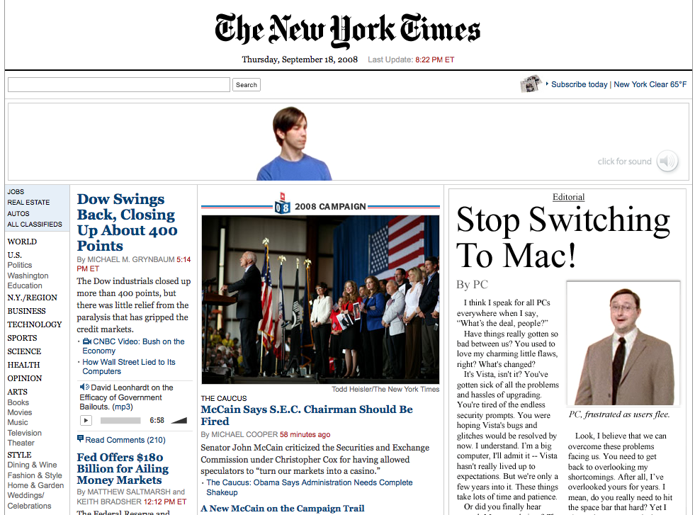
Native Advertising

Slide 56
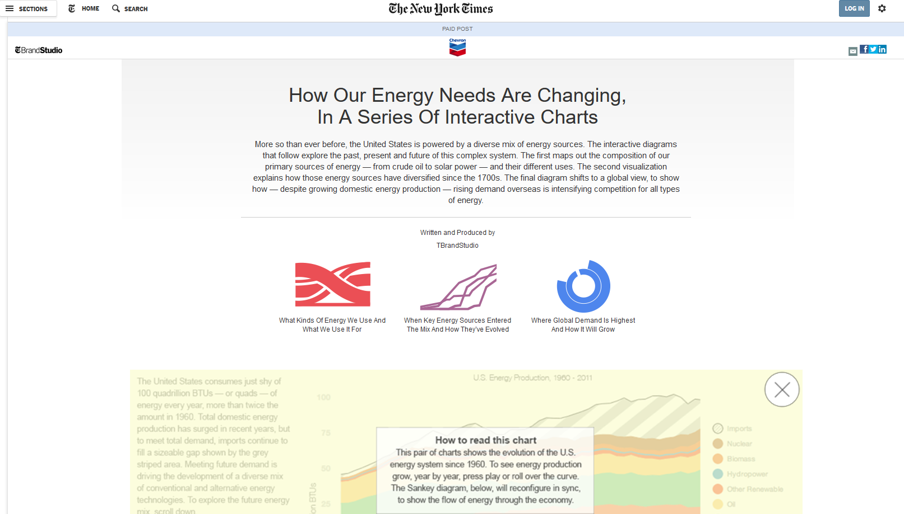
Advertorial

Slide 57

Fake Coupons

Slide 58
Coupons: How to tell it is fake
It was not posted by the retailer's verified social media account
The referring URL is not the official retailer’s site
The discount is too good
There’s no fine print
They ask you to fill out a survey to get the coupon
They ask for credit card numbers or banking information on those cutomer surveys.
They ask for personal information but don’t have a privacy policy.

Slide 59
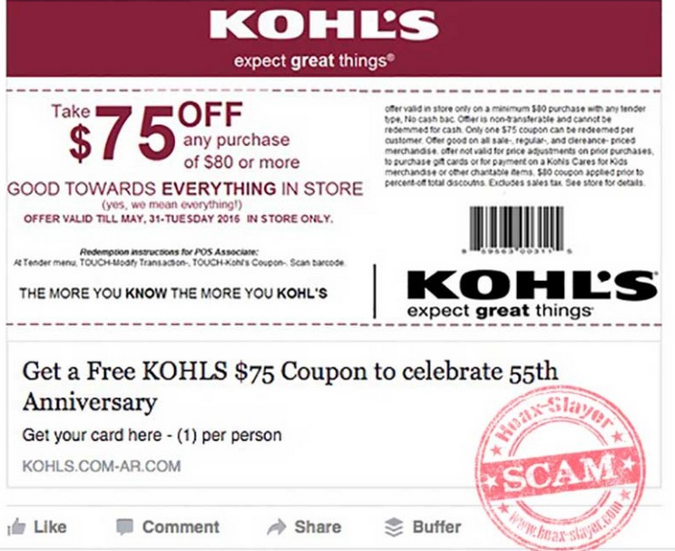
What’s wrong with this picture?

Slide 61


Slide 62
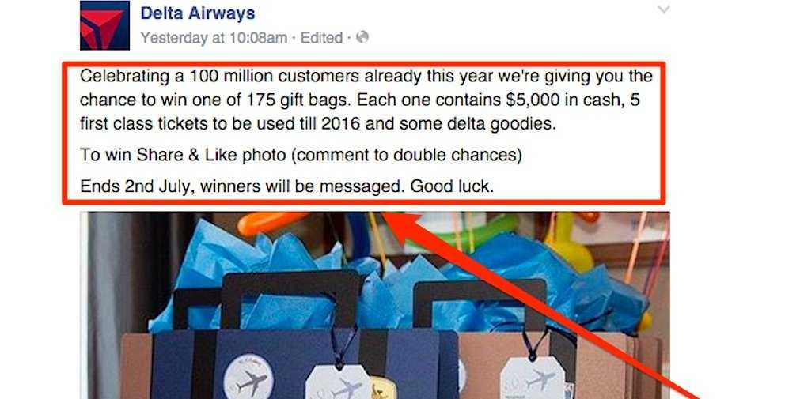
Fake Surveys and Giveaways

Slide 63
How to tell a fake giveaway
Punctuation or extra words in the name.
Off brand
  Low quality photos
  Unprofessional language (bad grammar, misspellings, etc.).
No fine print
It’s too good to be true
It requires you to like, share or comment on the post to get your prize (against Facebook’s policies)

Slide 64
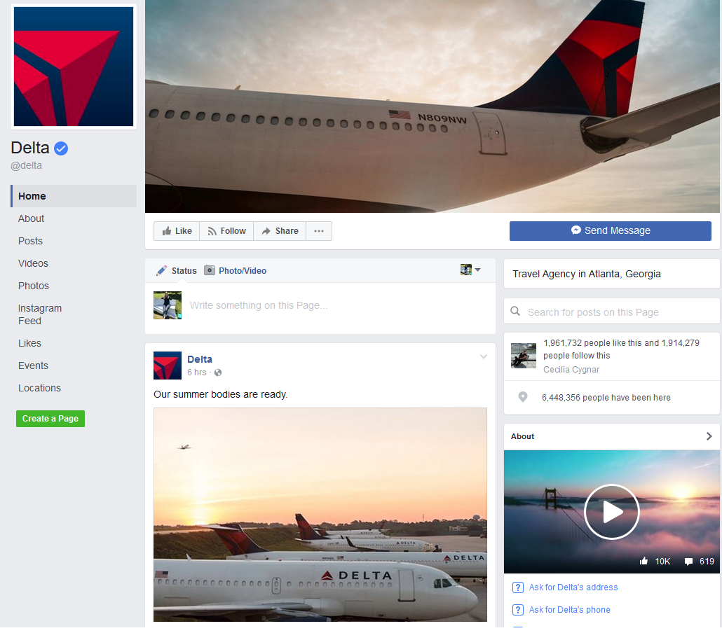
Delta’s official Facebook page

Slide 65
Typosquatting

Slide 66
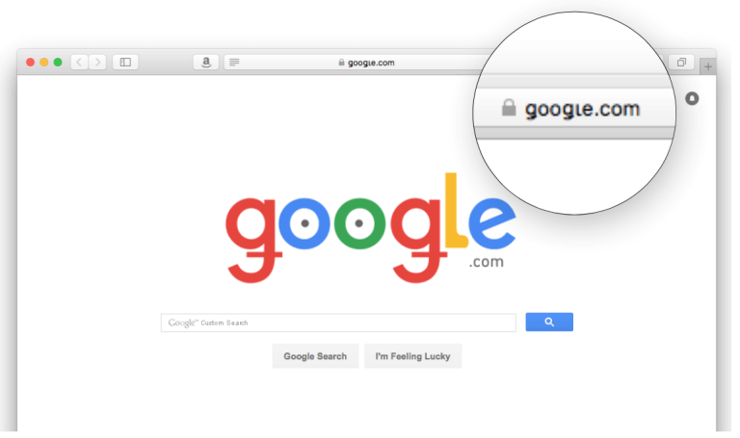
Typosquatting
mimic official sites/sources
URL hijacking
Using .com instead of .org or .edu

Slide 67
Fake Surveys and Giveaways
How do we know it is fake?

Slide 68
Twitter bots and fake accounts

Slide 69
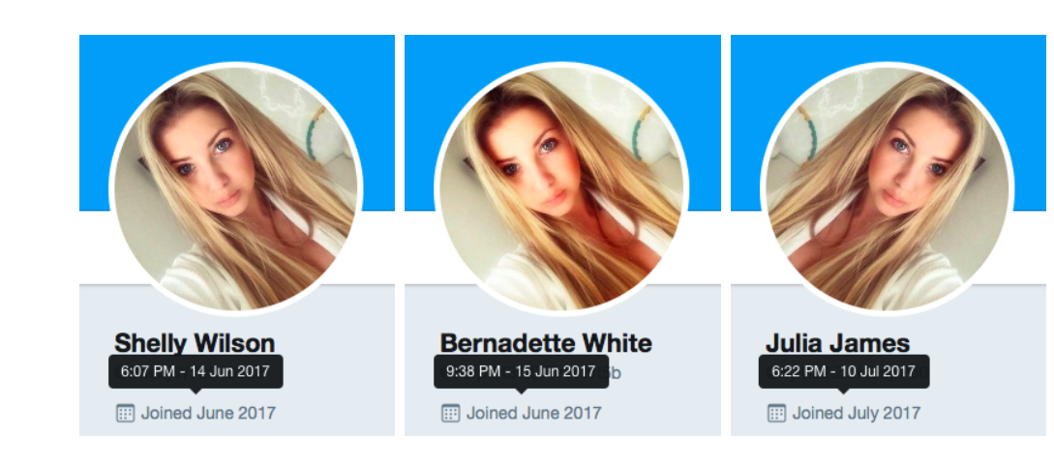
How to spot a bot or fake account
Not a lot of personal information in the profile
Profile picture is an avatar/cartoon
Or is stolen/duplicated across different profiles
  Do a reverse image search
And only have that one photo
Name on profile is backwards or a jumble
Same picture belongs to many profiles

Slide 70
How to spot a bot or fake account
Have thousands of friends/followers or a small handful
Too many posts a day (close to or over 100)
Lots of retweets and direct shares (without any added commentary)
Few or no original posts
Belongs to thousands of commercial groups from all over the world
They don’t reply to direct messages

Slide 71
Fake videos and websites
/

Slide 72

Fake videos
“Breaking News” from Radiolab
Notes:
http://futureoffakenews.com/videos.html https://goo.gl/ZT7Gnh
This podcast episode explores the future of false news and the ways in which advances in technology will make it even harder to distinguish between what is real and what is fake

Slide 73
How to know if a video is fake
Does the video flicker?
Is it a very short clip?
Does something seem off? D
Does the mouth movements match the words?
Use the same tactics we have discussed for other possible fake items
  Where did this come from?
  Who made it?
  Does this actually make sense?
  Compare the images in the video to other sources

Slide 74
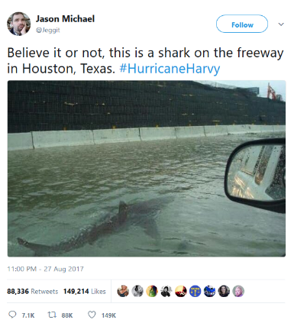
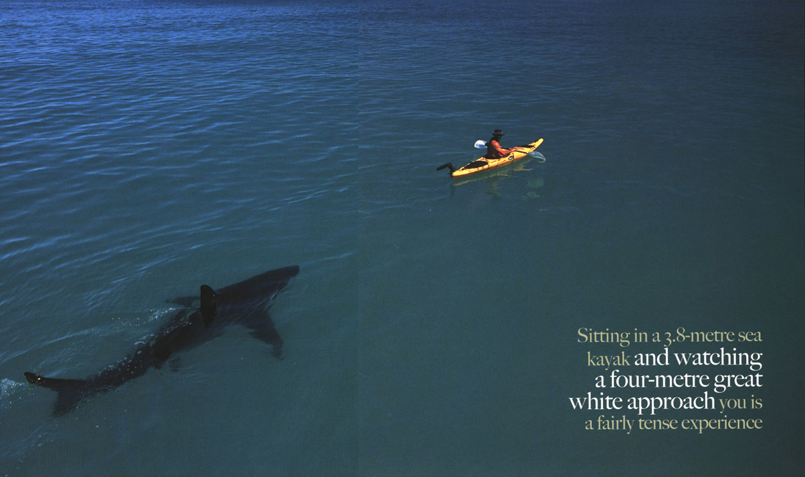
Fake pictures
Notes:
Many fake images that spread online aren’t fake in the sense that they’ve been manipulated, but fake in that the stories attributed to them are false

Slide 75
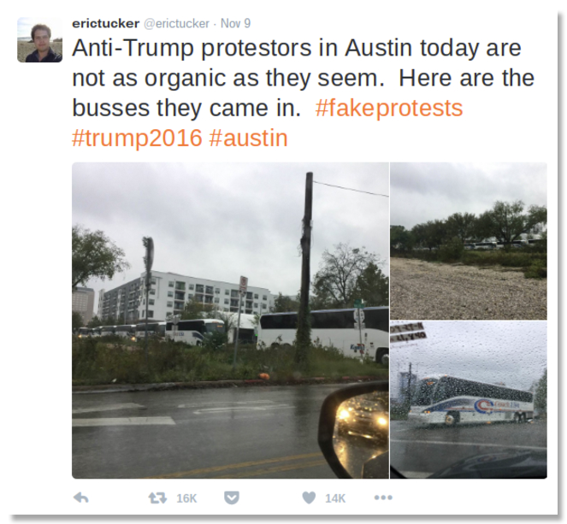
Fake context, real pictures
Not a fake image, but a fake story

Slide 76
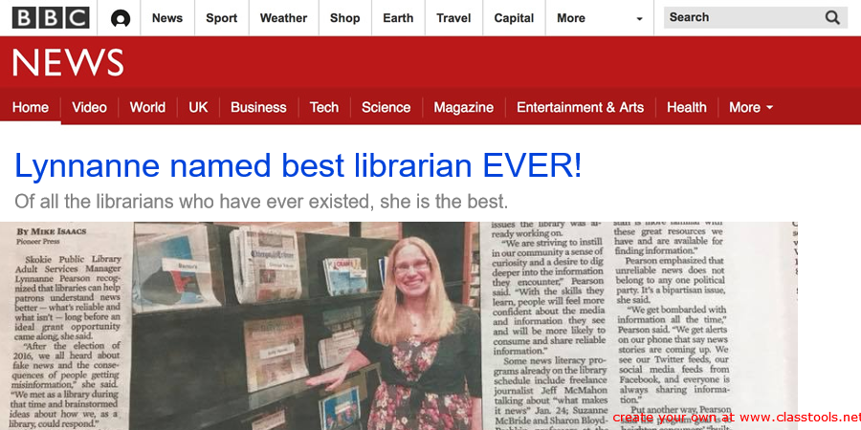
Faked Websites

Slide 77
If you remember nothing else from tonight except…
Be skeptical
Look deeper
Don’t share bad information
Examine your own bias
Read widely

Slide 78
Thank You
Want a copy of this presentation?
Visit www.skokielibrary.info/handouts
where this presentation will be available
for four weeks.

