Slide 1
Computer ABCs
By Sarah Mitchell-Mace
Learning Experiences
SMitchell-Mace@skokielibrary.info
December 17, 2017

Slide 2
What we’ll cover
Computer vs Laptop - equipment
Mouse
Computer Desktop
Any Questions

Slide 3
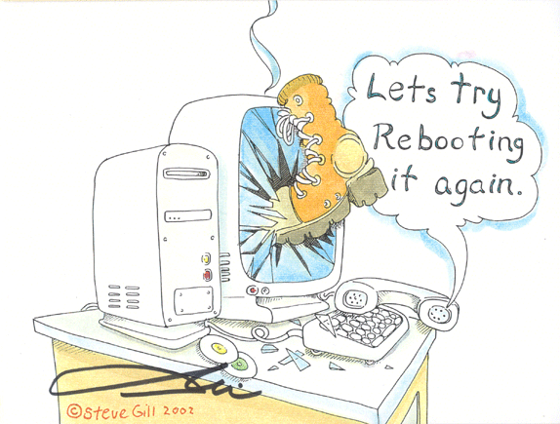

Slide 4
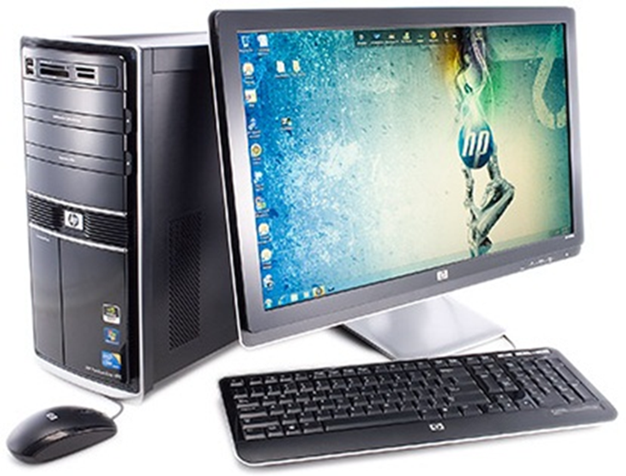
Computer System Unit
Monitor
Aka:
CPU (Central Processing Unit)
Computer Tower
Mouse
Keyboard

Slide 5
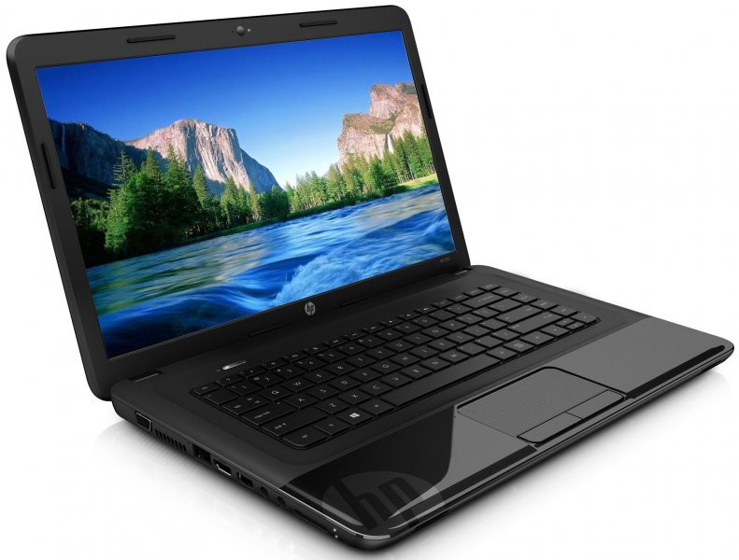
Monitor
Trackpad
(acts as
mouse)
Keyboard
CPU

Slide 6
Any questions?

Slide 7
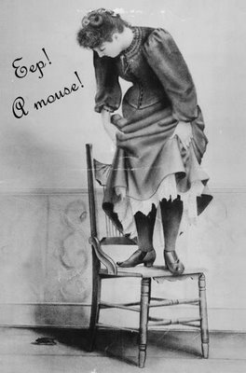
Don’t be sacred of the mouse!

Slide 8
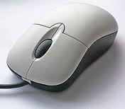

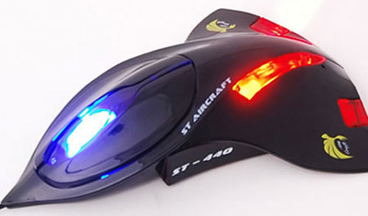
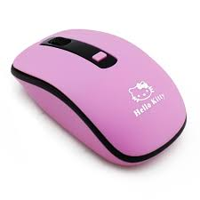
The mouse is an input device that allows you to interact with the computer.
Clicking a button on the mouse sends a signal to the computer to trigger an action

Slide 9
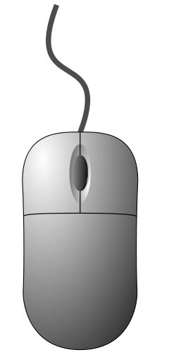
Scrolling wheel
Left button
Right button
The left and right buttons are used for clicking
The scroll wheel is used for scrolling up and down long pages

Slide 10
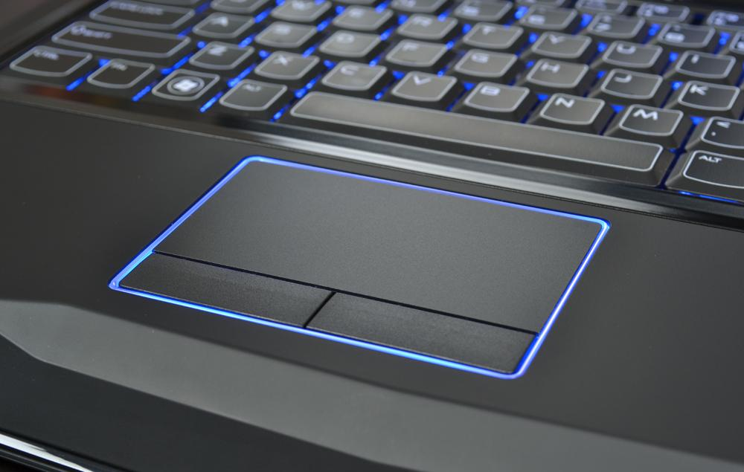
Laptop touchpad or trackpad
Notes:
A touchpad or trackpad is a pointing device featuring a tactile sensor, a specialized surface that can translate the motion and position of a user's fingers to a relative position on the operating system that is made output to the screen

Slide 11
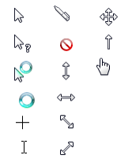



What does it mean to…..?
Click
Single-Click
Double-Click
Right- Click
Hold
Drag
Hover

Slide 12
Any questions?

Slide 13
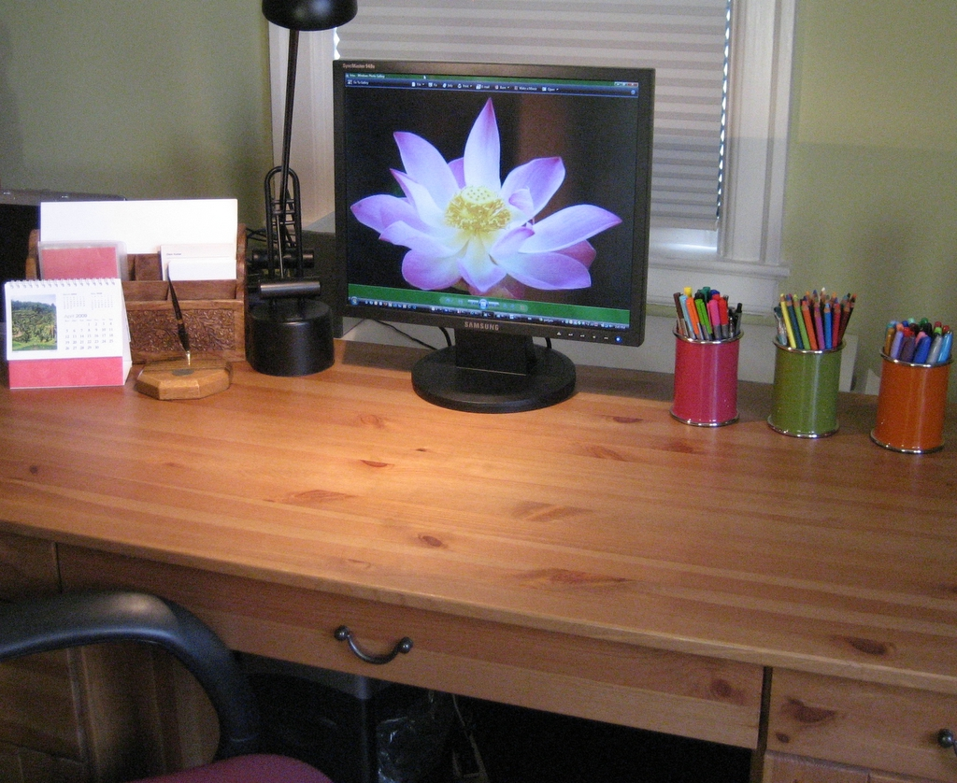
Your Desktop

Slide 14
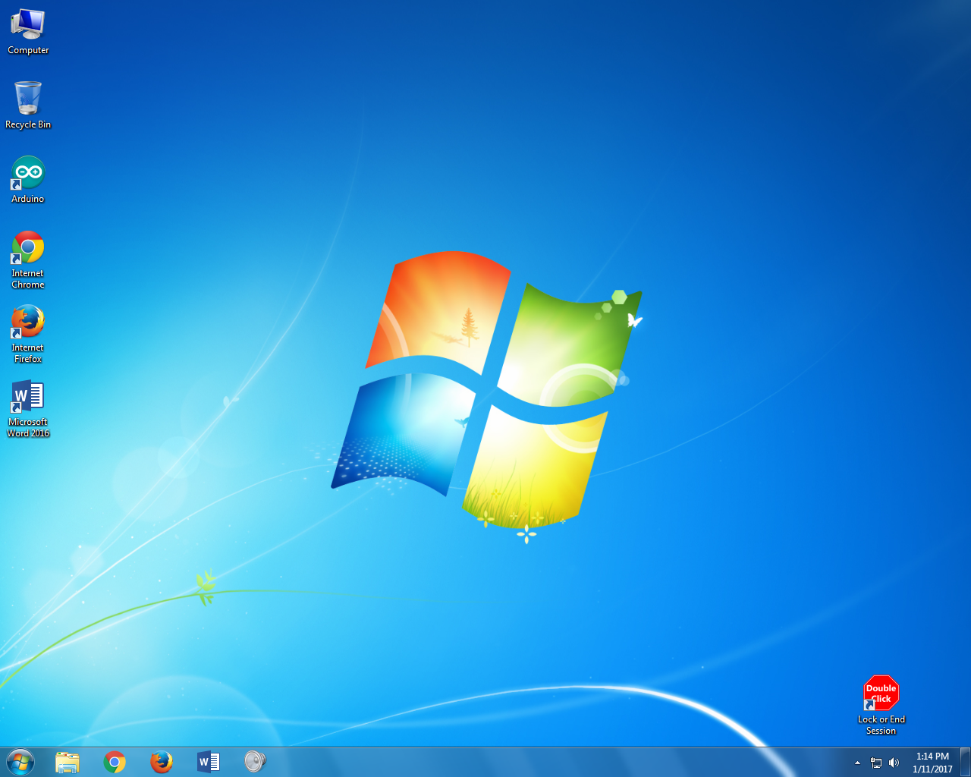
Your Desktop
Icons
Shortcuts
Start button
(start menu)
Taskbar

Slide 15
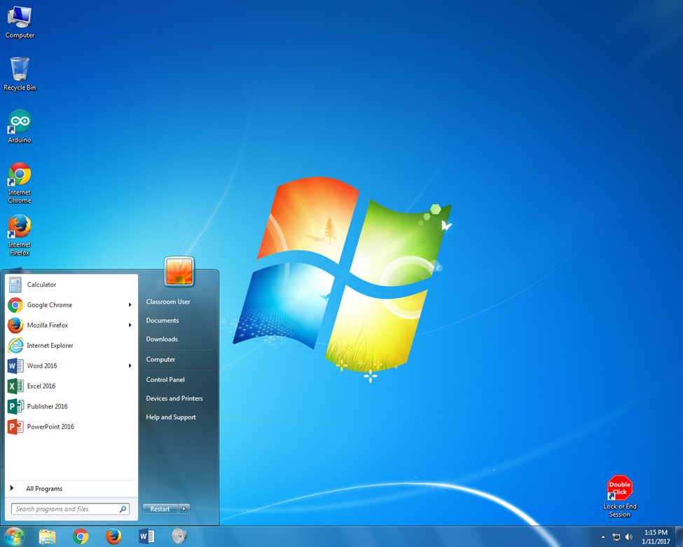
Your Desktop – Start Menu
Notes:
The Microsoft Windows Start Menu is the primary location in Windows to locate your installed programs and find any files or folders. By default, the Start menu is accessed by clicking the Start button, located in the bottom left-hand corner of the Windows Desktop screen.

Slide 16
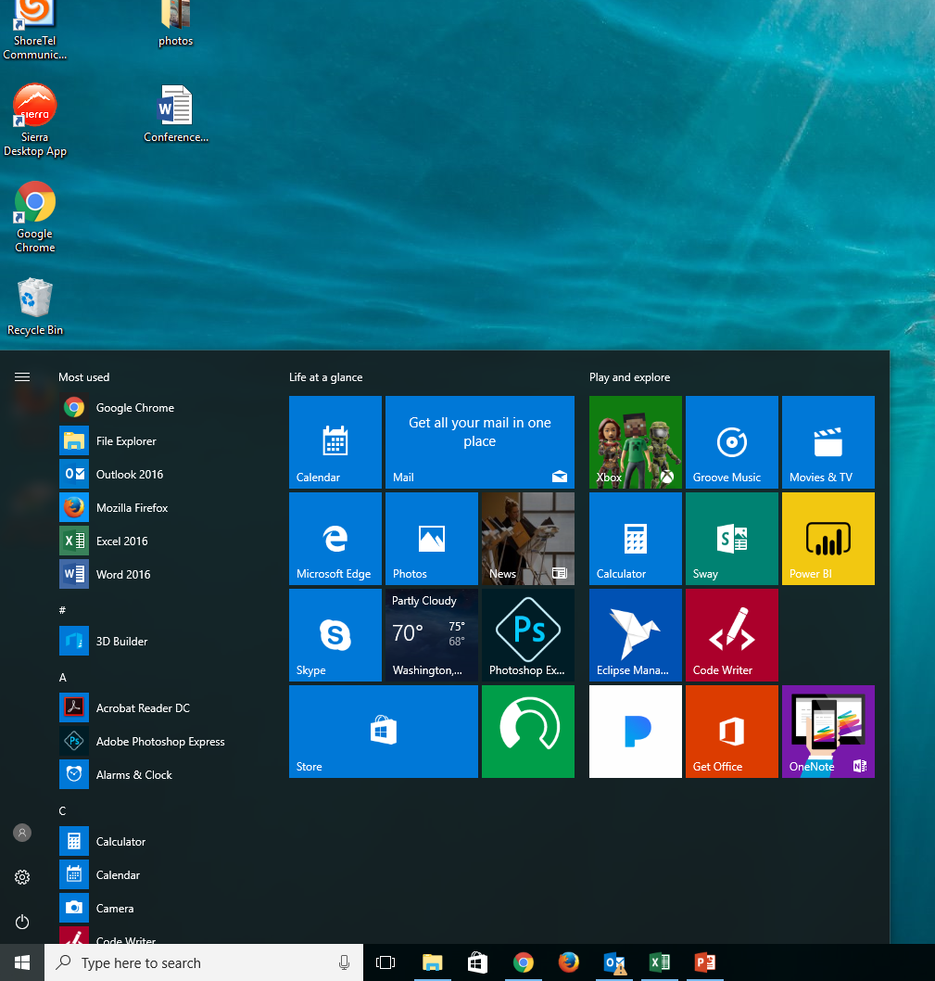

Slide 17
Practice time!
http://pbclibrary.org/mousing/mousercise.htm

Slide 18
Any questions?

Slide 19
Resources:
http://pbclibrary.org/mousing/mousercise.htm
1:1 sessions at the library
Teen Tech drop in

Slide 20
Thank You
Want a copy of this presentation?
Visit www.skokielibrary.info/handouts
where this presentation will be available
for 60 days.

