Slide 1

Piece of Cake:
Best Cooking and Baking Apps
Lynnanne Pearson
Skokie Public Library
October 23, 2017

Slide 2
All the apps will be free. Some are freeium

Slide 3




Not-free apps
How to Cook everything
Meal board
Martha Stewart Cookies
Paprika Recipe Manager

Slide 4

Big Names

Slide 5


Martha Stewart Everyday Food Collection
Access to past Everyday Food issues
Looks just like the physical magazine
  But with interactive elements
Add recipes to favorites
  No way to send the recipe to a friend
  Can take a screenshot

Slide 6

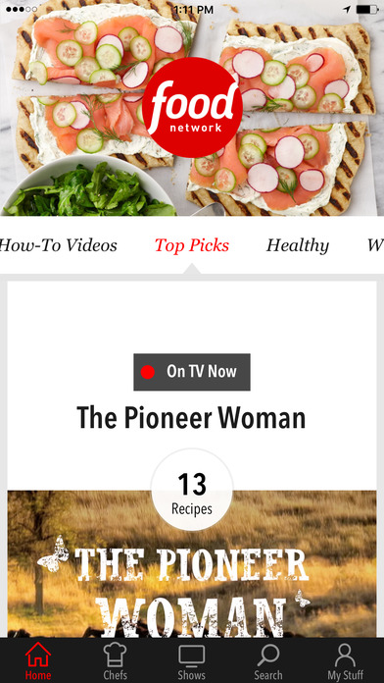
Food Network in the Kitchen
50,000 recipes from your favorite Food Network personalities
Search by chef or shows
Seasonal collections of recipes
How-to videos plus videos from shows
Save recipes and add notes to recipes

Slide 7

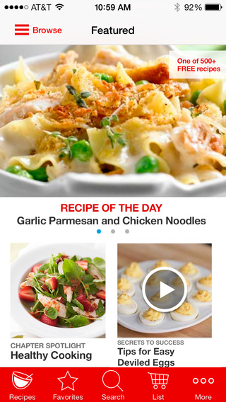
Better Homes and Gardens
More than 570 recipes
151 how-to videos
Share recipes with friends
Personalize the recipes
Recipe box
Create shopping lists

Slide 8
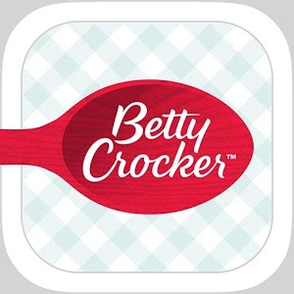
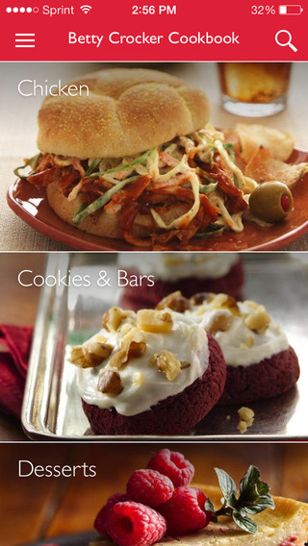
Betty Crocker Cookbook
15,000+ recipes
Surprise Me feature
Save favorites
Cook mode for app
Check off steps & ingredients as you cook
Substitutions and conversion charts

Slide 9

Allrecipes
Recipes from over 30 million home cooks
Each recipes has
  Directions
  Reviews
  Similar recipes
Dinner Spinner (on phones)
Shopping list
Step-by-step cooking videos

Slide 10

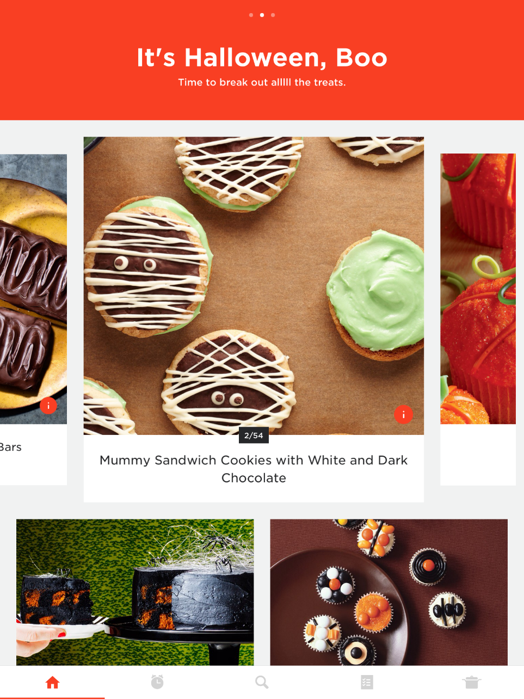
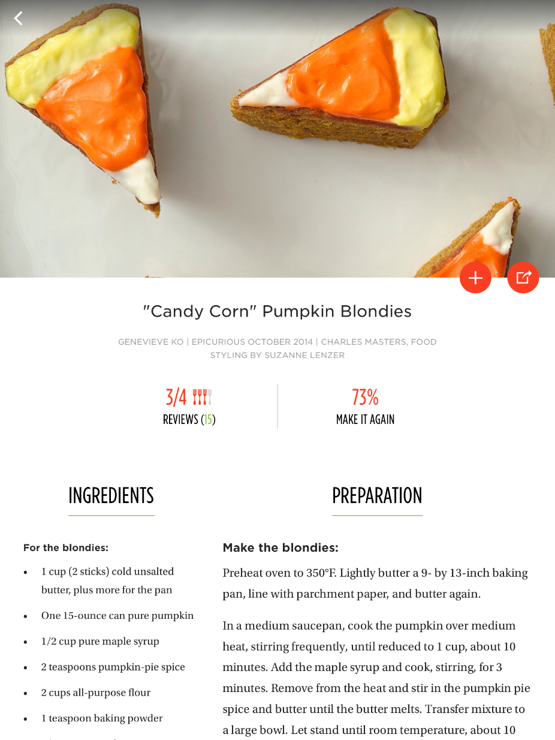
Epicurious
35000 tested recipes
Videos
Save fav recipes, start a shopping list
Kitchen timer
Seasonal ingredient finder

Slide 11
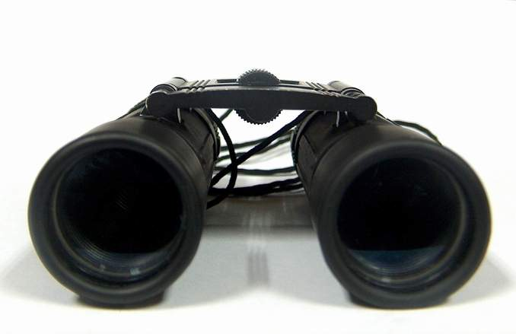
Beyond the Usual Suspects

Slide 12

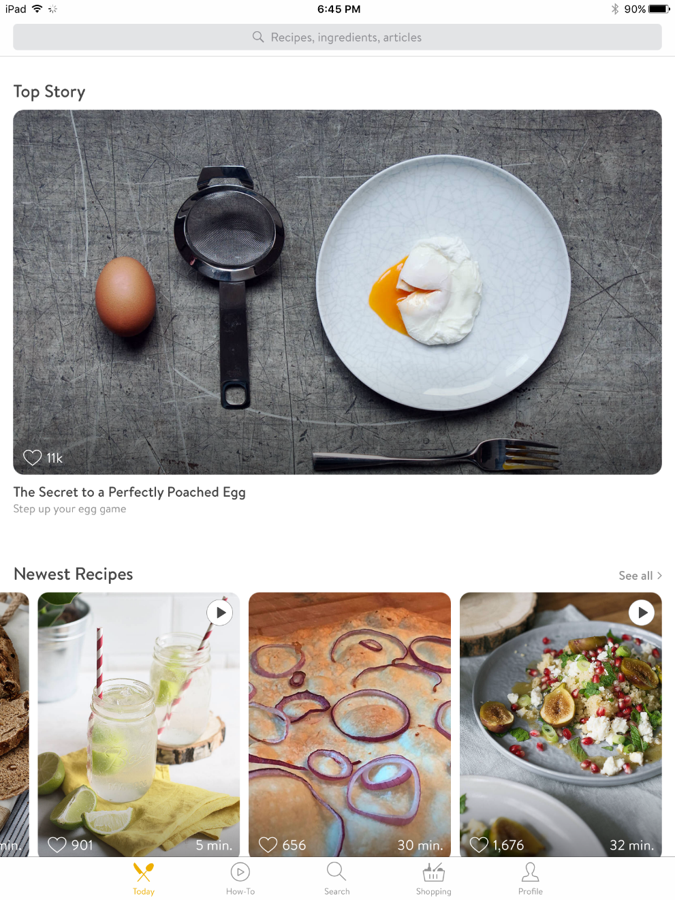
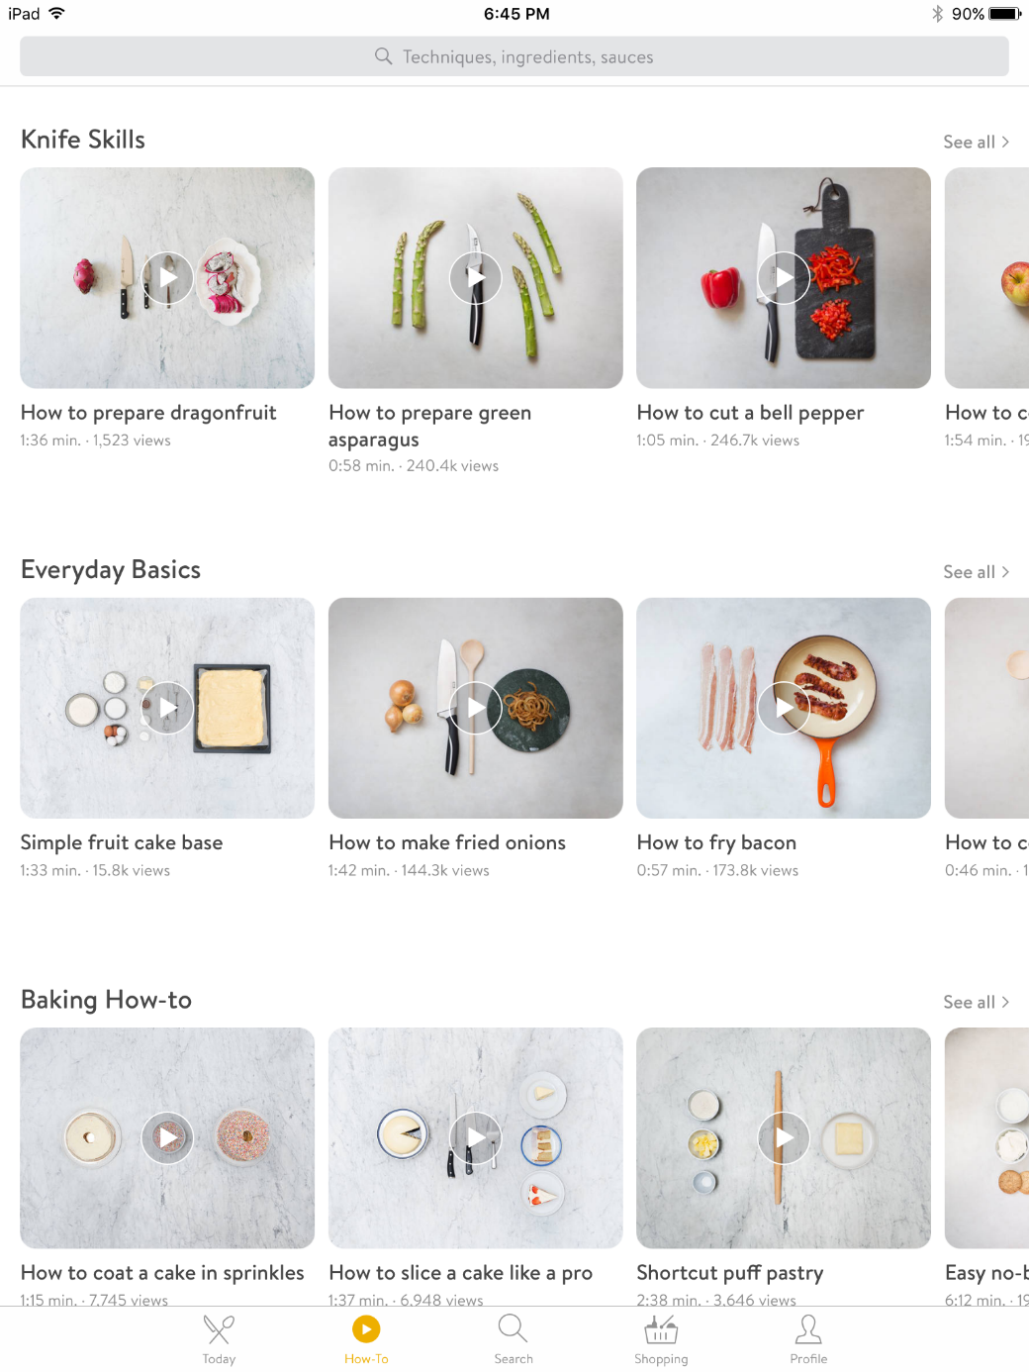
Kitchen Stories
Video recipes guides
Step-by-step photo instructions
How To-videos kitchen tips
Search by in-recipe tags
Utensils used
Create shopping lists
Save favorite recipes
Measurement converter

Slide 13

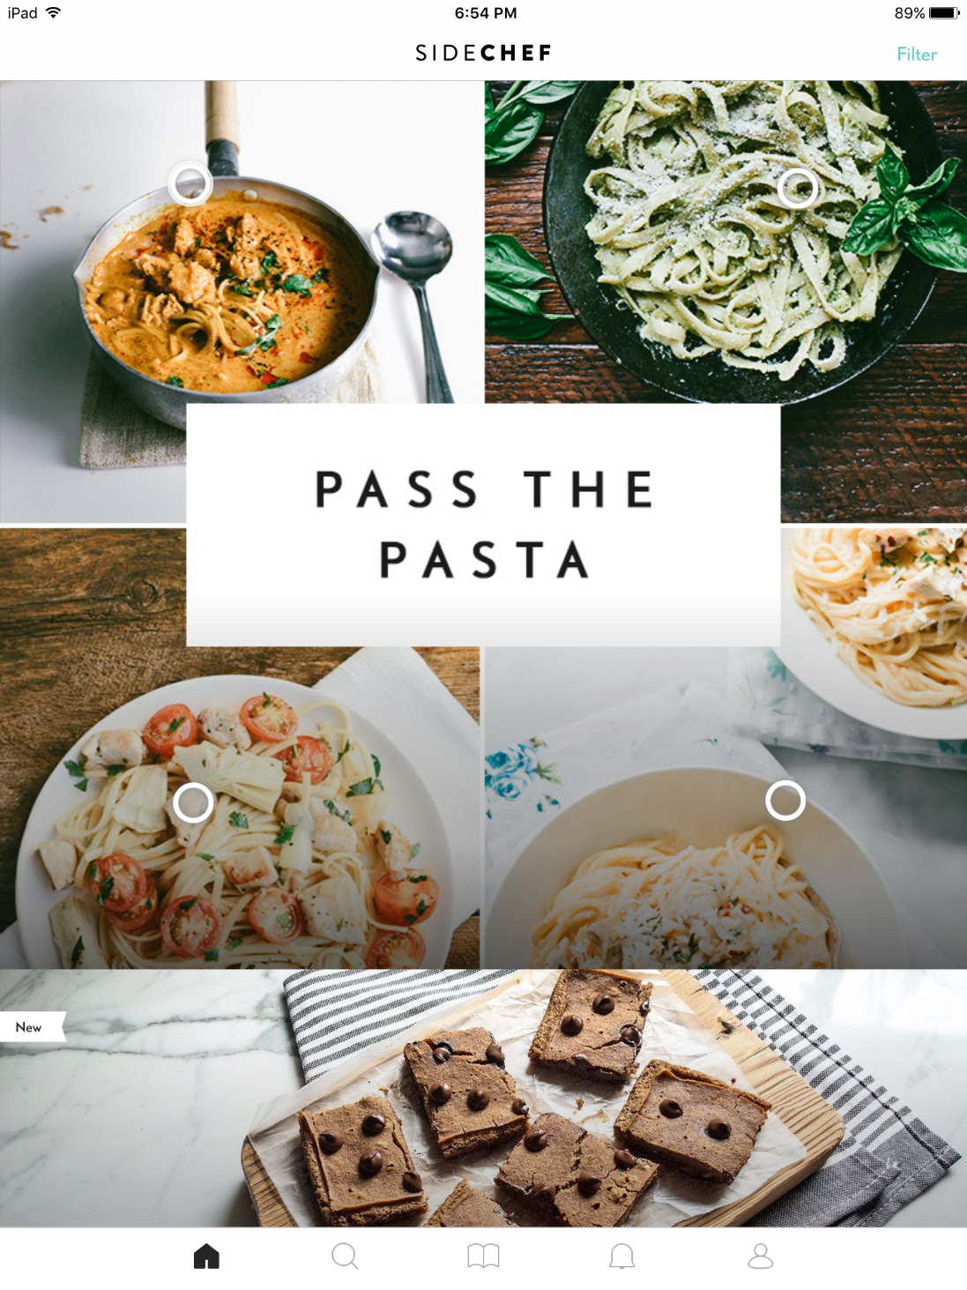
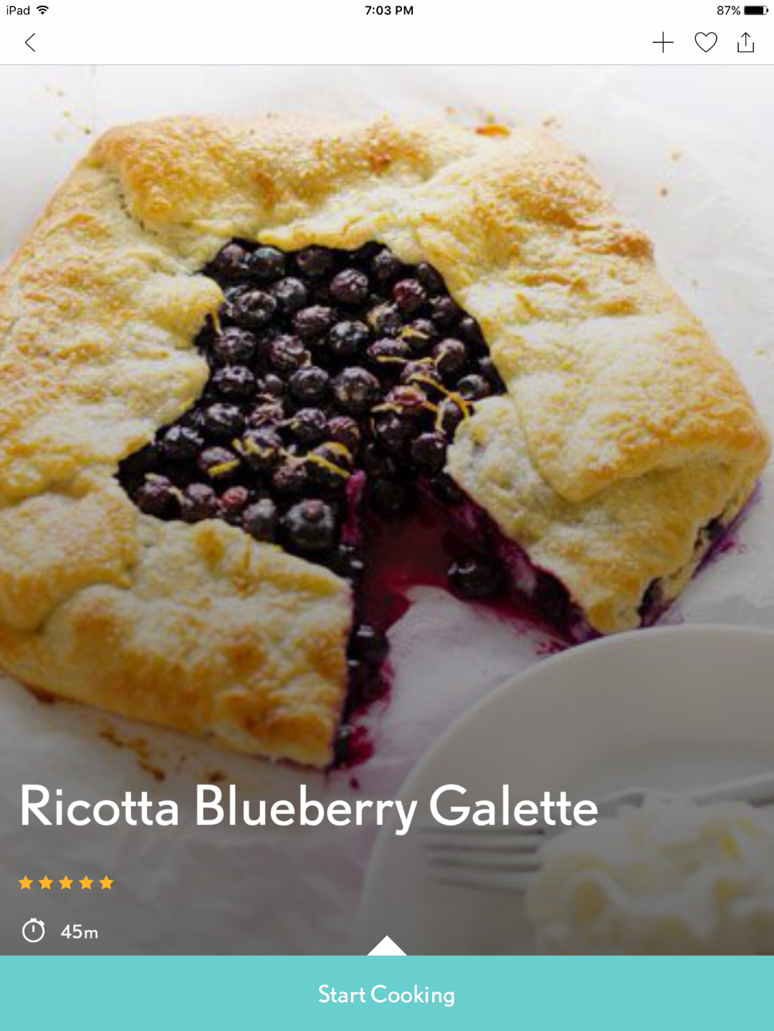
3500+ curated step-by-step recipes
Browse, share and save recipes
Upload& share your own recipe photos
Voice Instruction + Commands for hands free cooking
Ingredient Wikis
Adjust the serving size to fit your needs and the ingredients will convert automatically

Slide 14

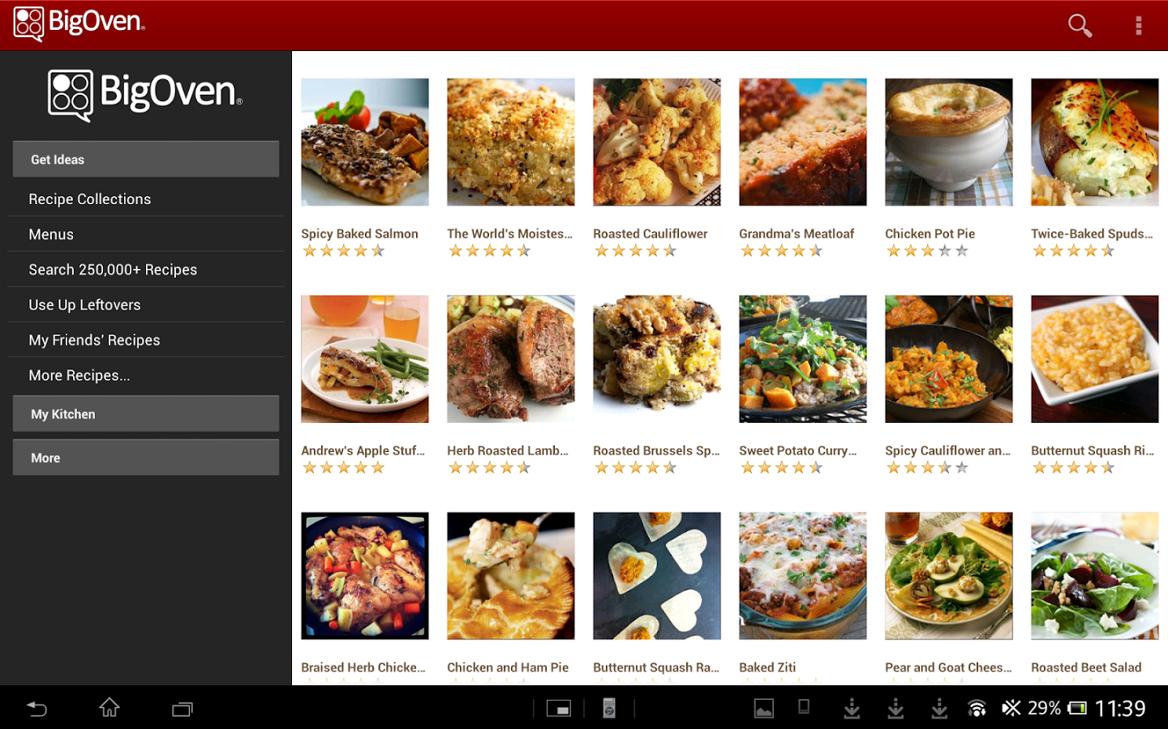
Big Oven
Big Oven
Named Best App by PC Magazine, Time and HuffPost
350,000 recipes
Grocery List
Menu Planner
Leftovers
Pro Membership

Slide 15

Yummly Recipes
Collates recipes from popular sites and blogs
Need to create a free account first
Personalized experience
Click Yum to save a recipe
Add items to your grocery list directly from recipe
App suggests related recipes for items on your grocery list

Slide 16

Hello Cupcake!
Based on the bestselling series of Hello, Cupcake! books
How-to videos
Step-by-step instructions with stop-action photographs
Voice-overs that give you insider tips.
Free version gives you access to 10 cupcakes projects

Slide 17

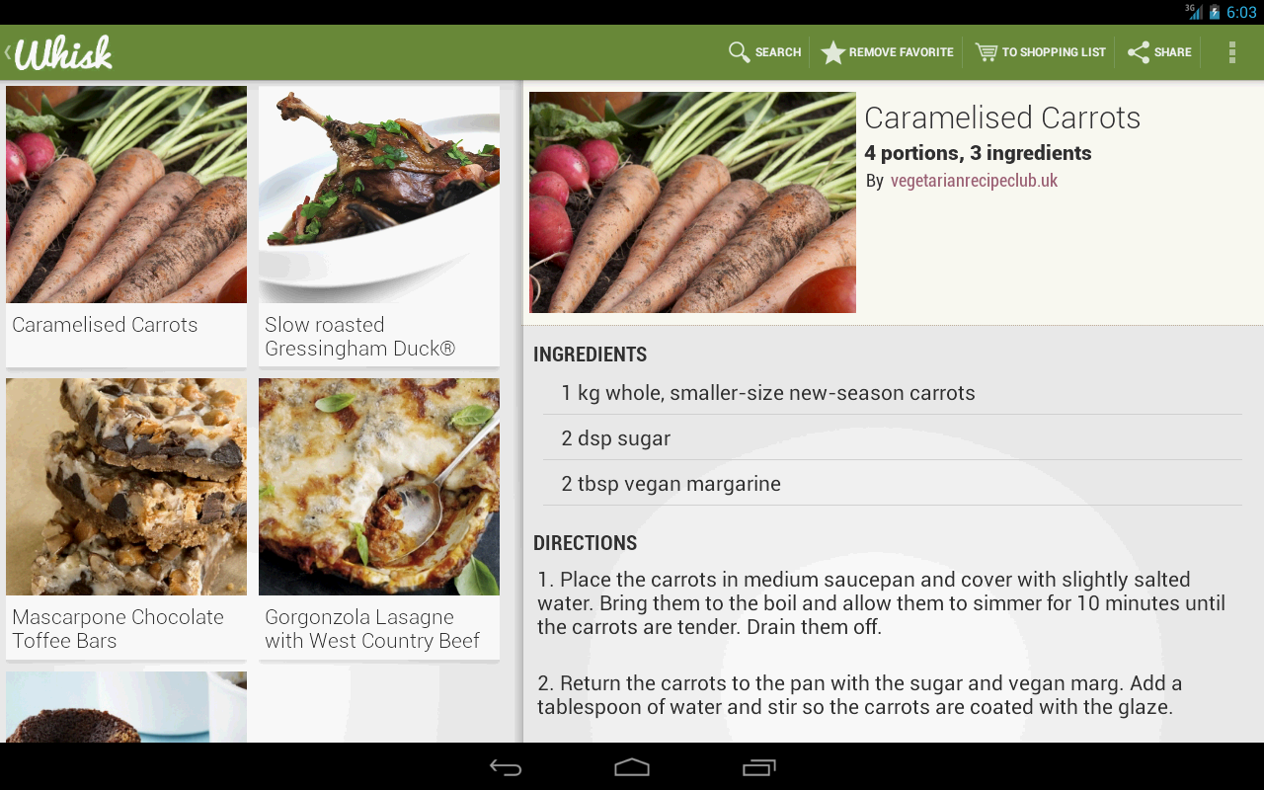
Whisk
Sign in to save and collect recipes
  300,000 recipes from leading recipe sites
Organize your recipes into categories like “Family dinners,” “Great salads” and “Desserts.”
Shopping Lists
  Create a shopping lists
  Create shopping lists for things you buy regularly.
  Add individual items or all the ingredients from a recipe to lists.
  Aisle by Aisle lists

Slide 18

Garden Plate
Vegetarian, vegan and gluten-free recipes
Add ingredients to shopping lists
Share your favorites with friends
Cons
  Not a lot of recipes so far
  Go Pro for $2.99 to have access all of the recipes

Slide 19

Foodily
Social Networking site for cooks
Like Pinterest, but just for recipes
Can follow “Tastemakers” like celebrity chefs, bloggers and cookbook authors
Fav a recipe and then add it to a list to create your boards
Save photos and recipes
Preview of recipe than tap “View at Website” button to see whole recipe

Slide 20

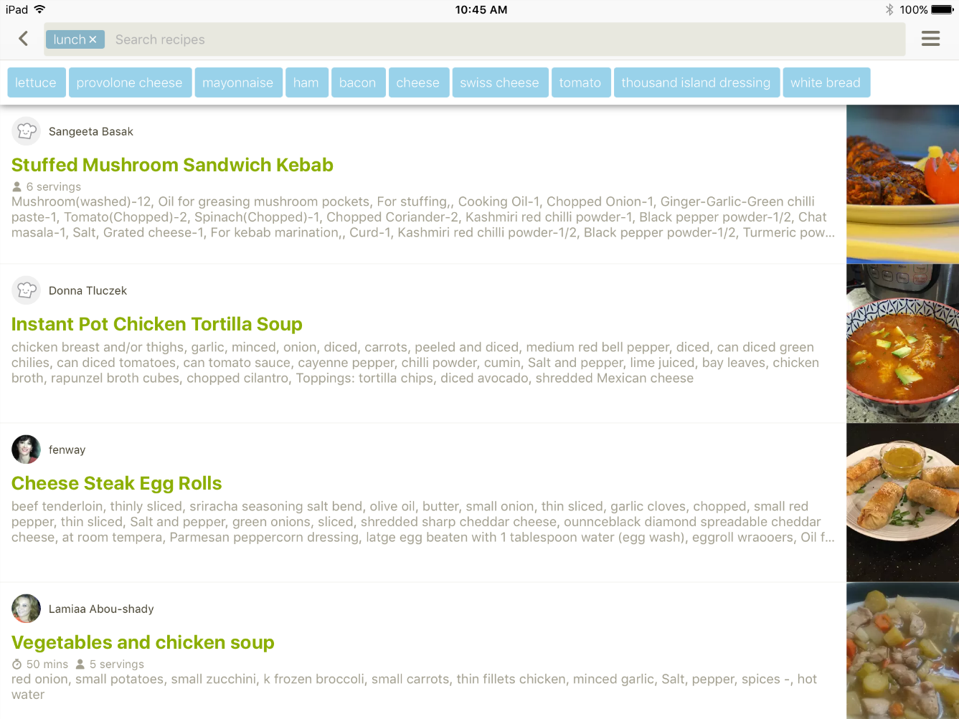
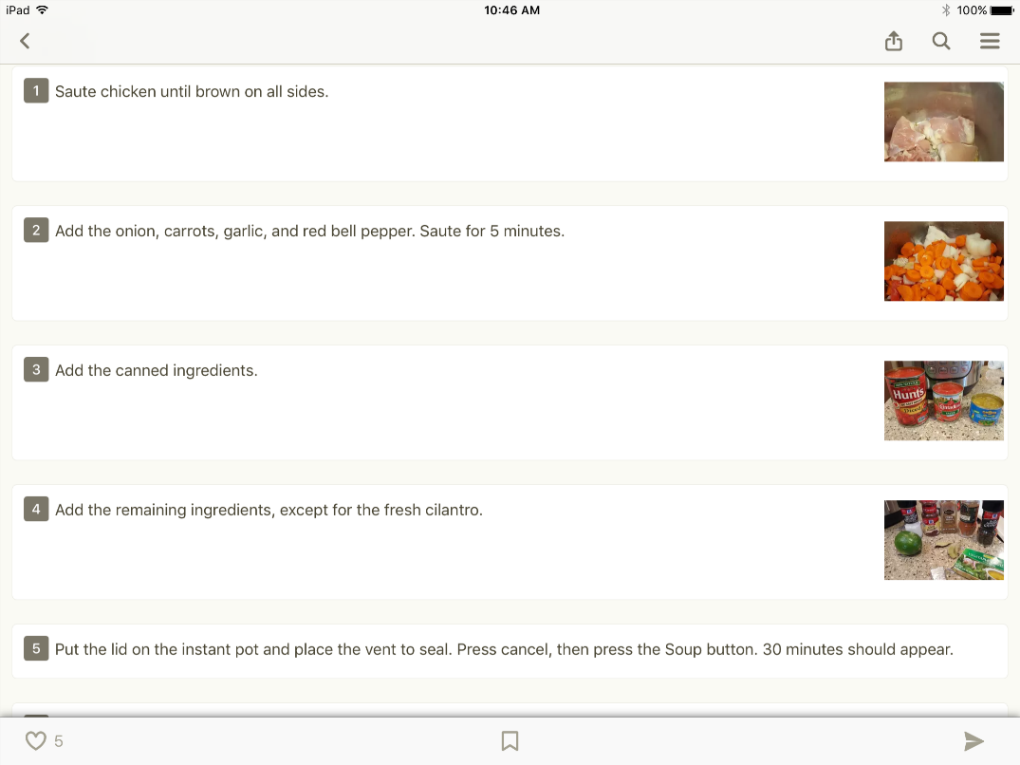
Cookpad
Publish and share recipes in public or private
Search for recipes by title, ingredients, meal-type or other
Social Features
Cooking diary
Bookmark recipes for quick access.
Find seasonal recipes for Halloween, Thanksgiving and Christmas dinners.

Slide 21

Copy Me That
Need to create an account
Copy recipes from their community, web or upload your own
Can then edit recipes you copy
  Tweak recipes you find on the internet
  Post pictures of how it turned out for you
Add ingredient to the shopping list
Add recipes to the calendar for meal planning

Slide 22
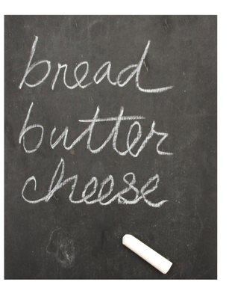
Grocery Shopping
Staying Organized
Learning New skills

Slide 23

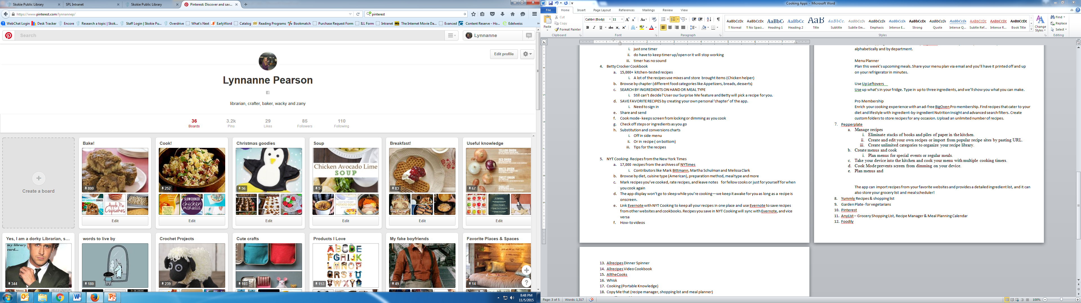
Pinterest
Not just for recipes, of course
Can make boards for the different recipes
Make Categories that personal
Easy to use
Preview of recipe in app, can click to see full recipe

Slide 24

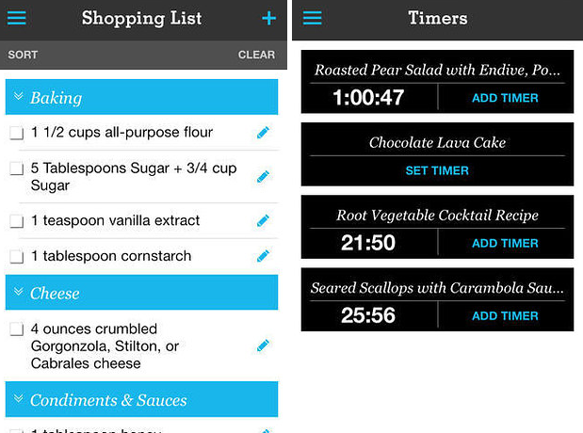
Pepperplate
Need to create a free account.
Upload and save your favorite recipes
Create & plan menus
Cook Mode
Multiple timers
Works in conjunction
with their website.

Slide 25
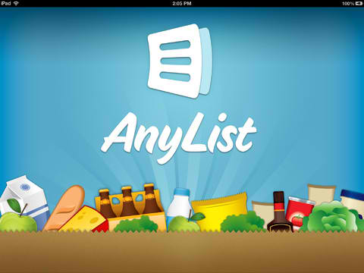
AnyList
Create organized lists
  App will categorize the list for you
  Add ingredients from stored recipes to lists
  Share lists with family and friends
Import recipes from the internet
Lists sync across iOS devices
Can buy yearly subscription for more features

Slide 26
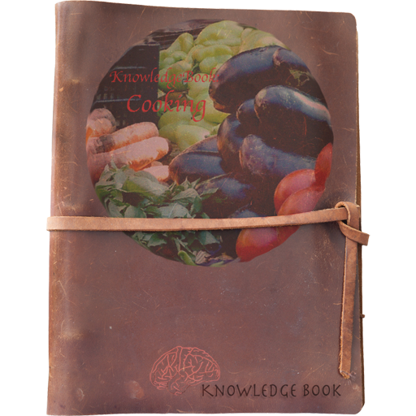
Cooking:
Portable Knowledge
A cooking app with no recipes!
Contains hints and tips
Yields
Substitutions
Dictionary of popular cooking terms
Very basic app- good for beginners
Old-fashion looking

Slide 27

Escoffier Cook’s Companion
Ultimate kitchen tool
Measurement converter
Kitchen timer
Ingredients compendium
Equipment List
Glossary of culinary terms

Slide 28

Get Cooking!
Want a copy of this presentation?
Visit www.skokielibrary.info/handouts
where this presentation will be available for four weeks.

