Slide 1
Open for Business:
Website User Testing

Slide 2
What are usability tests?

Slide 3
Usability testing refers to evaluating a product or service by testing it with representative users.
Typically, during a test, participants will try to complete typical tasks while observers watch, listen and takes notes.
The goal is to identify any usability problems, collect qualitative and quantitative data and determine the participant's satisfaction with the product.
Notes:
https://www.usability.gov/how-to-and-tools/methods/usability-testing.html

Slide 4
Benefits of Usability Testing
Learn if participants are able to complete specified tasks successfully
Identify how long it takes to complete specified tasks
Find out how satisfied participants are with your website and therefore, discover changes to improve satisfaction
Notes:
https://www.usability.gov/how-to-and-tools/methods/usability-testing.html

Slide 5
But wait!

Slide 6
“Elaborate usability tests are a waste of resources. The best results come from testing no more than 5 users and running as many small tests as you can afford.” via the Nielsen Norman Group
Notes:
https://www.nngroup.com/articles/why-you-only-need-to-test-with-5-users/

Slide 7
Identifying your participants

Slide 8
Existing clients
Friends and family
Consider age, prior education, familiarity with the business and/or site, web proficiency, etc.

Slide 9
Types of Usability Testing

Slide 10
Card sorting
Task scenarios
Open-ended questions

Slide 11
Card Sorting

Slide 12
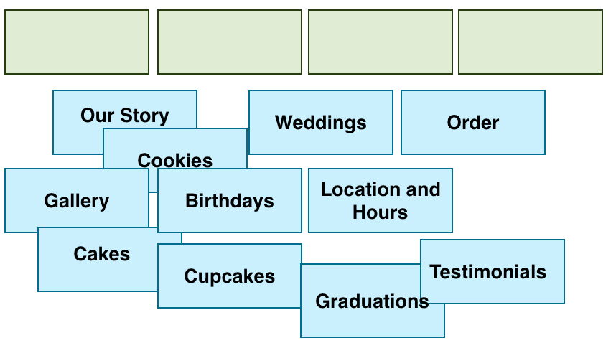

Slide 13
Card Sorting
Open (no labels)
  Generative, rather than evaluative
  Best if you’re starting to design a new website
Closed (labels provided)
  Is your info well-placed in existing categories? Do people agree?
  Pinpoint unclear or misleading category labels.
  Reduce the number of categories based on which ones are ignored the most

Slide 14
Card Sorting
Hybrid (label provided, ability to add new ones)
  Confident in category labels, but want to keep the option open “just in case”
    Find out if participants come up with category labels that are better than the ones you have
    Avoid the risk of people “making do” with categories they may not wholly agree with

Slide 16
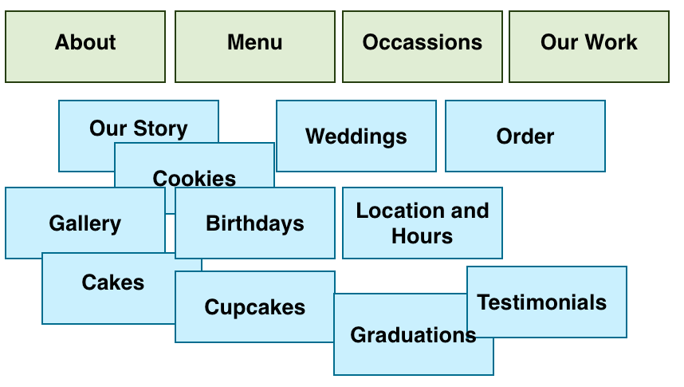

Slide 17
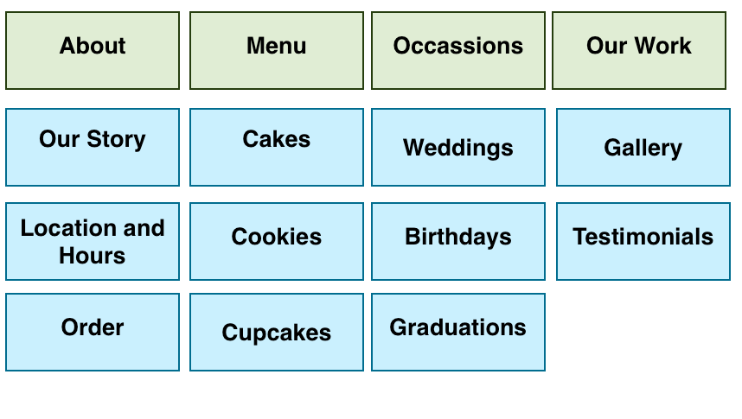

Slide 18
Task Scenarios

Slide 19
Task Scenarios
“The most effective way of understanding what works and what doesn’t in an interface is to watch people use it. This is the essence of usability testing.”
In order to observe participants you need to give them something to do. These assignments are frequently referred to as tasks.
  To avoid making participants feel like they’re being tested, you can call them “activities.”
Notes:
https://www.nngroup.com/articles/task-scenarios-usability-testing/

Slide 20
Task Scenarios
Come up with a list of general user goals that visitors to your site may have. What are the most important things that every user must be able to accomplish on the site?
Turn these user goals into task scenarios.
Task scenarios need to provide context so users engage with the interface and pretend to perform business or personal tasks as if they were at home or in the office.
Notes:
https://www.nngroup.com/articles/task-scenarios-usability-testing/

Slide 21
Writing Task Scenarios
Make the task realistic
  User goal: Browse product offerings and purchase an item
  Poor task: Purchase a pair of orange Nike running shoes
  Better task: Buy a pair of shoes for less than $40

Slide 22
Writing Task Scenarios
Make the task actionable
  User goal: Find movie and show times.
  Poor task: You want to see a movie Sunday afternoon. Go to www.fandango.com and tell me where you’d click next.
  Better task: Use www.fandago.com to find a movie you’d be interested in seeing on Sunday afternoon.

Slide 23
Writing Task Scenarios
Avoid giving clues and describing the steps
  User goal: Look up grades.
  Poor task: You want to see the results of your midterm exams. Go to the website, sign in, and tell me where you would click to get your transcript.
  Better task: Look up the results of your midterm exams.

Slide 24
Open-Ended Questions

Slide 25
Open-Ended Questions
You can ask questions before, during and after
Gain deeper insights by prompting people to answer with sentences, lists and stories
Open-ended questions allow you to find more than you anticipate

Slide 26
Open-Ended Questions: Tips
Start open questions with “how” or with words that begin with “w,” such as “what,” “when,” “where,” “which,” and “who.”
Don’t start questions with “was” (an exception to the “w” tip) or other forms of the verbs “to be” and “to do.”
In general, avoid “why” questions, because human nature leads people to make up a rational reason even when they don’t have one. We normally ask “why” only about ratings, to tease out more open-ended feedback. Say “Please tell me more about that,” instead.

Slide 27
Open-Ended Questions: Tips
Aim to collect stories instead of one- or two-word answers.
Even when you must ask closed-ended questions, you can ask an open-ended question at the end, such as, “What else would you like to say about that?”
Adding Other __________ to a set of multiple-choice answers is also a good way to get open-ended feedback.

Slide 28
Open-Ended Questions: Examples
Don’t (Closed) | Do (Open)
Are you satisfied? | How satisfied or dissatisfied are you with this process?
Did it act as you expected? | What would (did) you expect to happen when you ... ?
Did you find it? | Before a task: Please tell me when you’ve found the item. After a task: Where did you find the answer? Where was the item? What did you find?
Have you done this before? | What kinds of questions or difficulties have you had when doing this in the past? What happened when you did this before? Please describe your level of experience with …

Slide 29
What do I say?

Slide 30
Let them know how long it will take
Emphasize that you are testing the site, not them
Ask them to think out loud and to be as honest as possible (you won’t have hurt feelings!)
Let them know that you may not answer their questions right away, as you are seeking to see how they would use the site without assistance
Notes:
http://www.sensible.com/downloads/test-script.pdf

Slide 31
Final reminders

Slide 32
There is no magic bullet.
Imperfect data is still better than no data.

Slide 33
Thank you!

