Slide 1
Interviewing In The Virtual Age
Presented by Frances J. Price, MSHRMD

Slide 2
Agenda
Brief Introduction
Objective: To better prepare you for the virtual interviews
Types of possible interview formats in this virtual environment
Virtual Interviews on the various media platforms – Zoom, Teams, …
Review of what we have learned
Questions and Answers

Slide 4
Interesting Statistics
62%
of American adults would prefer an
in-person interview
*July 2020 Yoh study
86%
of organizations are now conducting
virtual interviews
*April 2020 press release by Gartner.com

Slide 5
Whether you are participating in an in-person or virtual interview your goal is the same — to make a lasting impression that earns you a subsequent interview or
a job offer.

Slide 7
Other Interviewing Methods That Are Being Utilized In This
Virtual Age

Slide 8
We Are Going To Focus on
Five (5) Types of Virtual/Interviews
In This Session

Slide 9
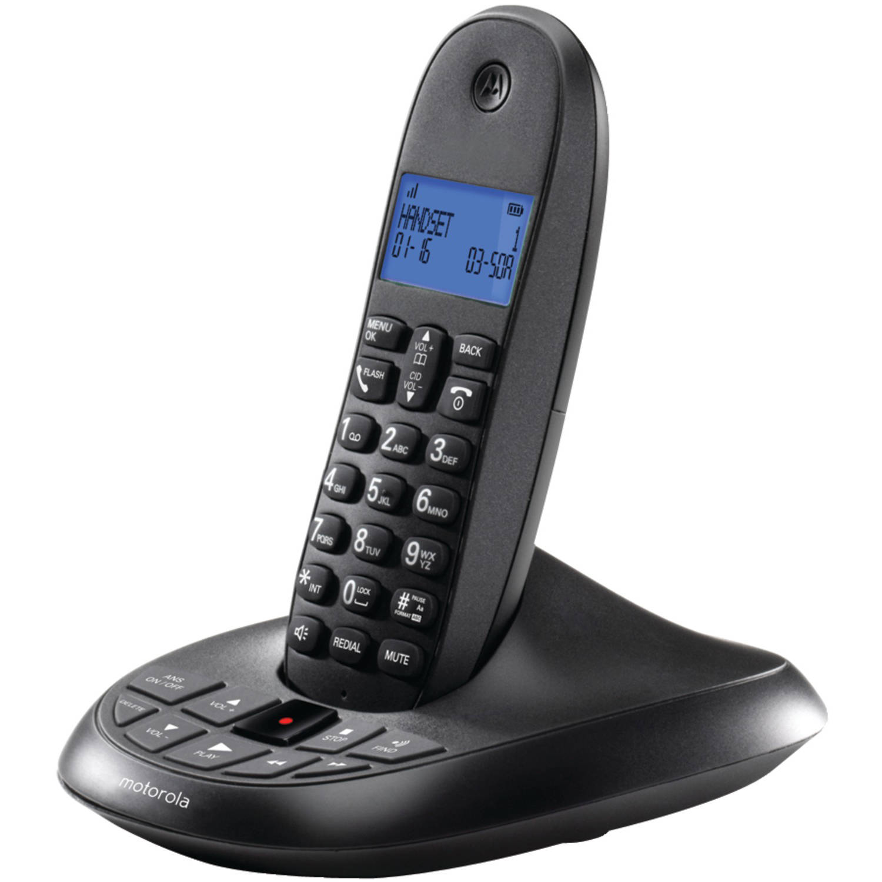
Telephone
Interview​

Slide 10
If Possible,
Use A
Land Line
Telephone
VS.
A Cell Phone

Slide 11
Prerecorded Interview Questions

Slide 12
You Have 2 Minutes To Come Up With A Quick Response To The Question They Have Asked You.
The System Will Allow You
1or 2 Tries, If You
Make A Mistake

Slide 13
Virtual Group Interview

Slide 14
Group Interviews With A Prerecorded Message Or A Live Presenter, But You Are Unable To See The 50 Other Candidates On The Zoom Meeting.
The Interviewer Will Send Out An Electronic Questionnaire To Find Out Your Continued Interest In The Position
After The Interview.

Slide 16
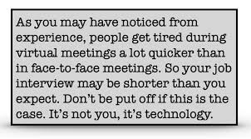

Slide 17
Virtual Panel Interview

Slide 18
An Applicant Interviewing With Multiple Interviewers
Some May Be Observers, Others May Actually Ask Interview Question, And Some Will Be Part Of Other Departments To Assess The Candidates Skills.

Slide 19
Text Interviews

Slide 20
A Recruiter, Hiring Manager, Or An Automated System Will Text You A Series Of Questions And You Have To Respond With An Answer In Order To Go To The Next Question. Based Upon Your Response, Will Determine If You Move Forward In The Process.

Slide 21
Virtual Interview

Slide 23
Tip # 1 Ask For Interviewing Assistance
If you have not interviewed in a long time this is also where the Career Services at your local libraries can help you brush up on your interviewing skills.
The library Career Counselors conducts mock interviews and provides you with great tips on how to interview more effectively.

Slide 24
Tip # 2 Practice, Practice, Practice
It’s important to keep things simple. Do not feel like you must give a long-winded answer. Being clear and concise is one of the most important things in a job interview.
Use The S.T.A.R. Method
Situation: Set the scene and give the necessary details of your example. Task: Describe what your responsibility was in that situation. Action: Explain exactly what steps you took to address it. Result: Share what outcomes your actions achieved.
* The Muse

Slide 25
Keep your answers to two minutes or less if possible. Why you ask?
How many of you have heard the question in the interview and responded for so long you forgot what the original question was; in fact you cannot recall if you answered the question correctly.
Be detailed enough to respond accordingly but brief enough not to bore the interview with you long response.

Slide 26
Prepare smart questions for your interviewers.
Interviews are a two-way street. Employers expect you to ask questions: they want to know that you are thinking seriously about what it would be like to work there. Here are some questions you may want to consider asking your interviewers: Practice your interview responses aloud, this promotes confidence in what you are sharing with the interviewer.
Can you explain some of the day-to-day responsibilities this job entails?
How would you describe the characteristics of someone who would succeed in this role?
What departments does this team work with regularly?
How do these departments typically collaborate?
Describe the culture of the organization.
What are the challenges you are currently facing in this role?

Slide 27
Tip # 3 Test Your Technology
The minute you agree to a virtual interview, test your technology to ensure you are set up for success.
24-48 hours prior to the interview, test your equipment and internet connection again. Being technically savvy is one of the top 10 traits employers are looking for in a candidate.

Slide 29
Tip #4 Be Punctual
For a virtual interview, it is courteous to show up approximately 5 -10 minutes early. The benefits go beyond just showing that you are a punctual person. Arriving early for your online interview gives you a few extra minutes to log in just in case you have some technology challenges issues.

Slide 30
Tip #5 Prepare to be seen in the video

Slide 31
Prepare for the interview as you normally would for an in-person interview. Both you and your future employer will be meeting virtually, nevertheless basic etiquette still applies.
Good lighting, ability to share your screen, take some notes (mention this to the interviewer so they know why you are looking away), listen carefully, and avoid interruptions when you are speaking. Declutter your interviewing space . No virtual backgrounds or headphones.
Look your very best, you still want to make a positive impression even though it is over a video platform. Personal presentation is as important as if you were attending a face-to-face interview.
Notes:
Whether you're participating in an in-person or virtual interview your goal is the same — to make a lasting impression that earns you a subsequent interview or a job offer.

Slide 32
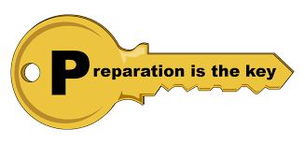

Slide 33
Tip #6 Be Prepared
Ultimately, the key to acing a virtual interview is proper preparation by conducting research before the meeting and ready for all questions will help set you apart from other applicants.
Sample questions below:
Why are you interested in this role?
What do you know about our company?
What are your biggest weaknesses?
What do you consider to be your biggest professional achievement?
Tell me about a challenge at work and how you dealt with it.
What are you looking for in a new position?
Why are you leaving your current role?

Slide 35
An important step in preparing is researching the company and your interviewers. Obtaining key information about the company and who you will be interviewing with can help you go into your interview with confidence. Using the company’s website, social media posts, recent press releases, articles, or utilizing your local library for assistance will be key for your preparation.

Slide 36
Tip #7 Be a friendly toward the interviewer
You will likely have a chance to virtually meet your future manager or other team members.
This is just as unusual for you as your manager, but this is now becoming common in the virtual age of interviewing.
This will require you both to relax and be open-minded. That said, please try to limit distractions and interruptions.

Slide 38
Tip #8 Listen Carefully
Sometimes when you are on a video job interview, it’s easy to accidentally cut someone off due to audio delays or from not paying attention to nonverbal cues. Keep your mind from drifting off and focus on active listening. Also, after your interviewer asks a question, wait a few seconds before speaking to avoid cutting in.

Slide 40
Tip #9 Speak Slowly and Clearly
Video interview technology can come with delays or instances when the microphone may not pick up your voice well. To prevent this from happening, take your time when speaking and enunciate your words. This will ensure that your interviewer can hear and understand you throughout your interview.

Slide 41
Tip #10: Focus On Communication
This is your chance to shine and convey your skills, abilities, and passion for the position.
The employer is paying attention to your communication skills and how you can handle yourself in different types of interview situations.
Focusing on how you speak and articulate key information is important. Feel comfortable asking questions or asking them to repeat the question if you did not clearly hear them or understand the question.

Slide 42
Always except the unexpected

Slide 43
Tip # 11 Be Yourself and Have Fun
Paint A Picture By Letting Your Personality Stand Out

Slide 44
Tip # 12 Immediately Follow Up
Address red flags that the employer may have or ask if you have described your skills effectively to outline your skills
Ask about timeline- next steps
Send a thank you note via email
Believe in yourself. Remember you are a great candidate that will add value to any organization.

Slide 45
What have we learned today about
interviewing virtually?
Tip # 1 Ask For Interviewing Assistance
Tip # 2 Practice, Practice, Practice
Tip # 3 Test Your Technology
Tip # 4 Be Punctual
Tip # 5 Prepare To Be Seen In The Video
Tip # 6 Be Prepared
Tip # 7 Be a Friendly Guest
Tip # 8 Listen Carefully
Tip # 9 Speak Slowly and Clearly
Tip # 10 Focus On Communication
Tip # 11 Be Yourself and Have Fun
Tip # 12 Immediately Follow Up

Slide 48
Virtual Interviewing Articles
https://www.forbes.com/sites/ashleystahl/2020/06/04/virtual-interview-tips-to-land-you-thejob-during-the-covid-19-pandemic/#6e98933e1bdc
https://myfuture.com/career/job-interview-tips
https://www.indeed.com/career-advice/interviewing/virtual-interview https://online.jwu.edu/blog/15-tips-acing-online-job-interview
https://www.themuse.com/advice/video-interview-tips
https://www.forbes.com/sites/maryabbajay/2020/04/20/be
https://www.glassdoor.com/blog/how-to-ace-your-virtual-interview/
https://employmenttechnologies.com/what-is-a-virtual-interview/

Slide 50
FJP Consulting Group
www.fjpconsultinggroup.com
fjphrteam@gmail.com
888-418-9929
https://www.linkedin.com/in/francesjprice
Strategies and Solutions for Designing a Positive Workplace for Organizations and Individuals| Career Development| Speaker | Human Resources Consultant

