Slide 1
Make Google Drive Work for You
Skokie Public Library
By: Ly Nguyen
Lnguyen@skokielibrary.info

Slide 2
Please introduce yourself!
One thing you want to learn today?
One interesting fact about yourself?

Slide 3



What We’re Learning Today
Navigating Google Drive
Uploading & downloading files
Creating a new file
Sharing files
Organizing with folders

Slide 4
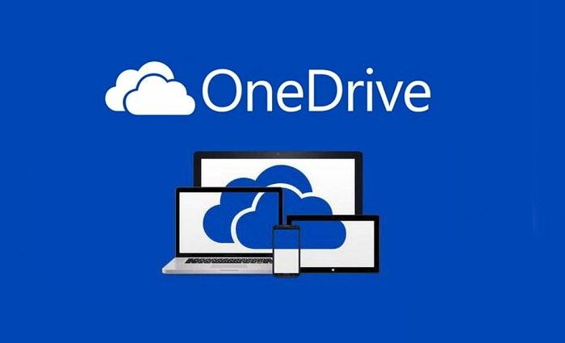


What is a “cloud drive?”
A “virtual filing cabinet” for all of your documents.
You can create and store documents on the internet
using a browser.

Slide 5

Why use a cloud drive?
    Convenience - access your files from any digital device.
    Back up files so you don’t lose them.
    Save space!
    Automatically save your progress.
    Share your files with others.
    Work on documents with others.

Slide 6
Let’s get started on Google Drive!

