Slide 1
Make Google Drive Work for You
Skokie Public Library
By: Ly Nguyen
Lnguyen@skokielibrary.info

Slide 2
Please introduce yourself!
One thing you want to learn today?
One interesting fact about yourself?

Slide 3


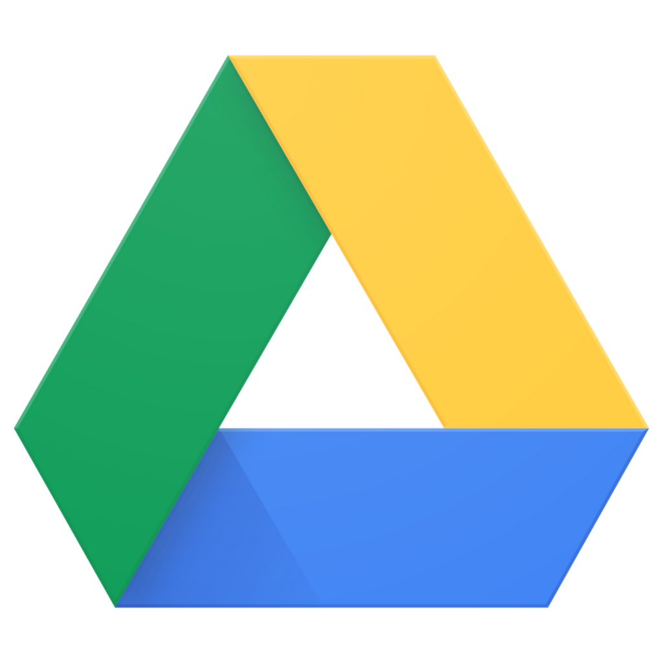
What We’re Learning Today
Navigating Google Drive
Uploading & downloading files
Creating a new file
Sharing files
Organizing with folders
Notes:
The goal for today is to help you feel comfortable getting started with Google Drive.
Today, I hope to work through the following:
navigate the menus,
upload and download files,
how to create a new file,
share files with others, and
use of folders to organize your documents.
If we don’t have time to cover some of things or there’s something you want to learn more about, we also offer 1 on 1 training for an hour long appointment with our information specialists like me.
Or you can feel free to stop at the information desk and we would be happy to help.
This workshop is not meant to be very structured, so please feel free to ask questions as we go along.

Slide 4
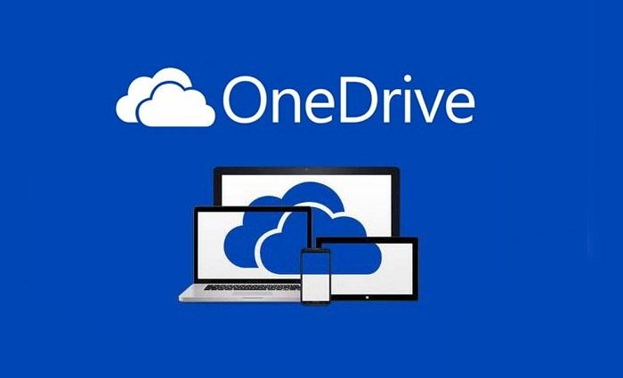
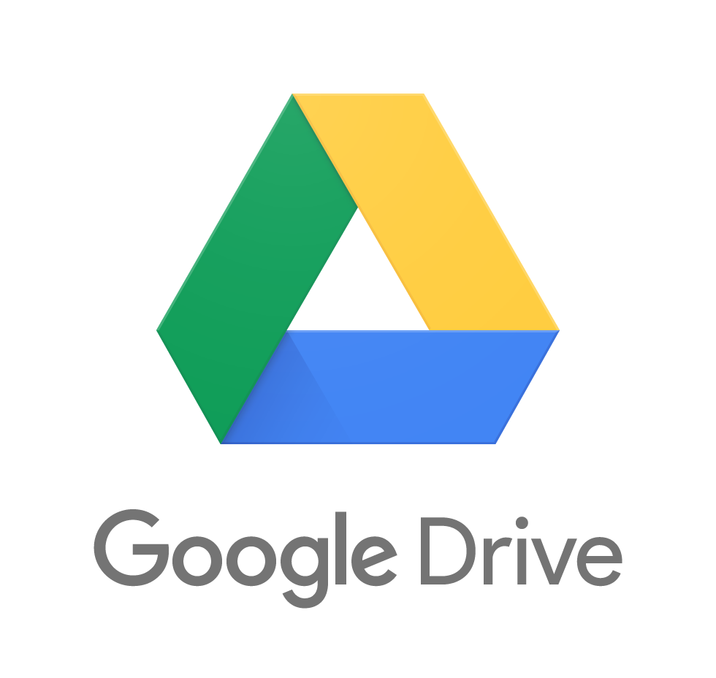

What is a “cloud drive?”
A “virtual filing cabinet” for all of your documents.
You can create and store documents on the internet
using a browser.
Notes:
Today we are talking about Google Drive, but other companies also have cloud drive services if you have an account. Popular ones include Microsoft OneDrive and Drop Box. You can do the same things on all of these services.

Slide 5

Why use a cloud drive?
    Convenience - access your files from any digital device.
    Back up files so you don’t lose them.
    Save space!
    Automatically save your progress.
    Share your files with others.
    Work on documents with others.
Notes:
Many of you may wonder why you would want to store files on a cloud drive. Some reasons include:
the convenience of accessing your documents from any computer or device that can connect to the internet using a browser, like Google Chrome or Internet Explorer.
You can back up your physical files too, in case they get lost or damaged.
Plus, digital files take up much less room.
If you edit documents with Google programs, such as Google Docs, Sheets, or Slides, the computer saves the changes automatically, so you don’t have to worry about losing your work.
A big benefit to using a cloud drive is that you can share your documents online. This includes by e-mail or sending someone a link so they can have access to your documents.
People use their cloud drive for work and school and for personal use so they can collaborate with other people. For example, it’s easier to work with someone who is in a different location or has a different schedule from you.

Slide 6
Let’s get started on Google Drive!

