Slide 1
Dungeons and Dragons:
A Primer
By Perry Nelson
Information Specialist

Slide 2

What the heck
is D&D?
Tabletop Role-Playing Game (TTRPG)
First edition initially published 1974, with the (most recent) fifth edition published 2014
Most popular TTRPG today and widely considered to have defined the genre after its initial publication

Slide 3
Why do I care?
It’s fun!

Slide 4
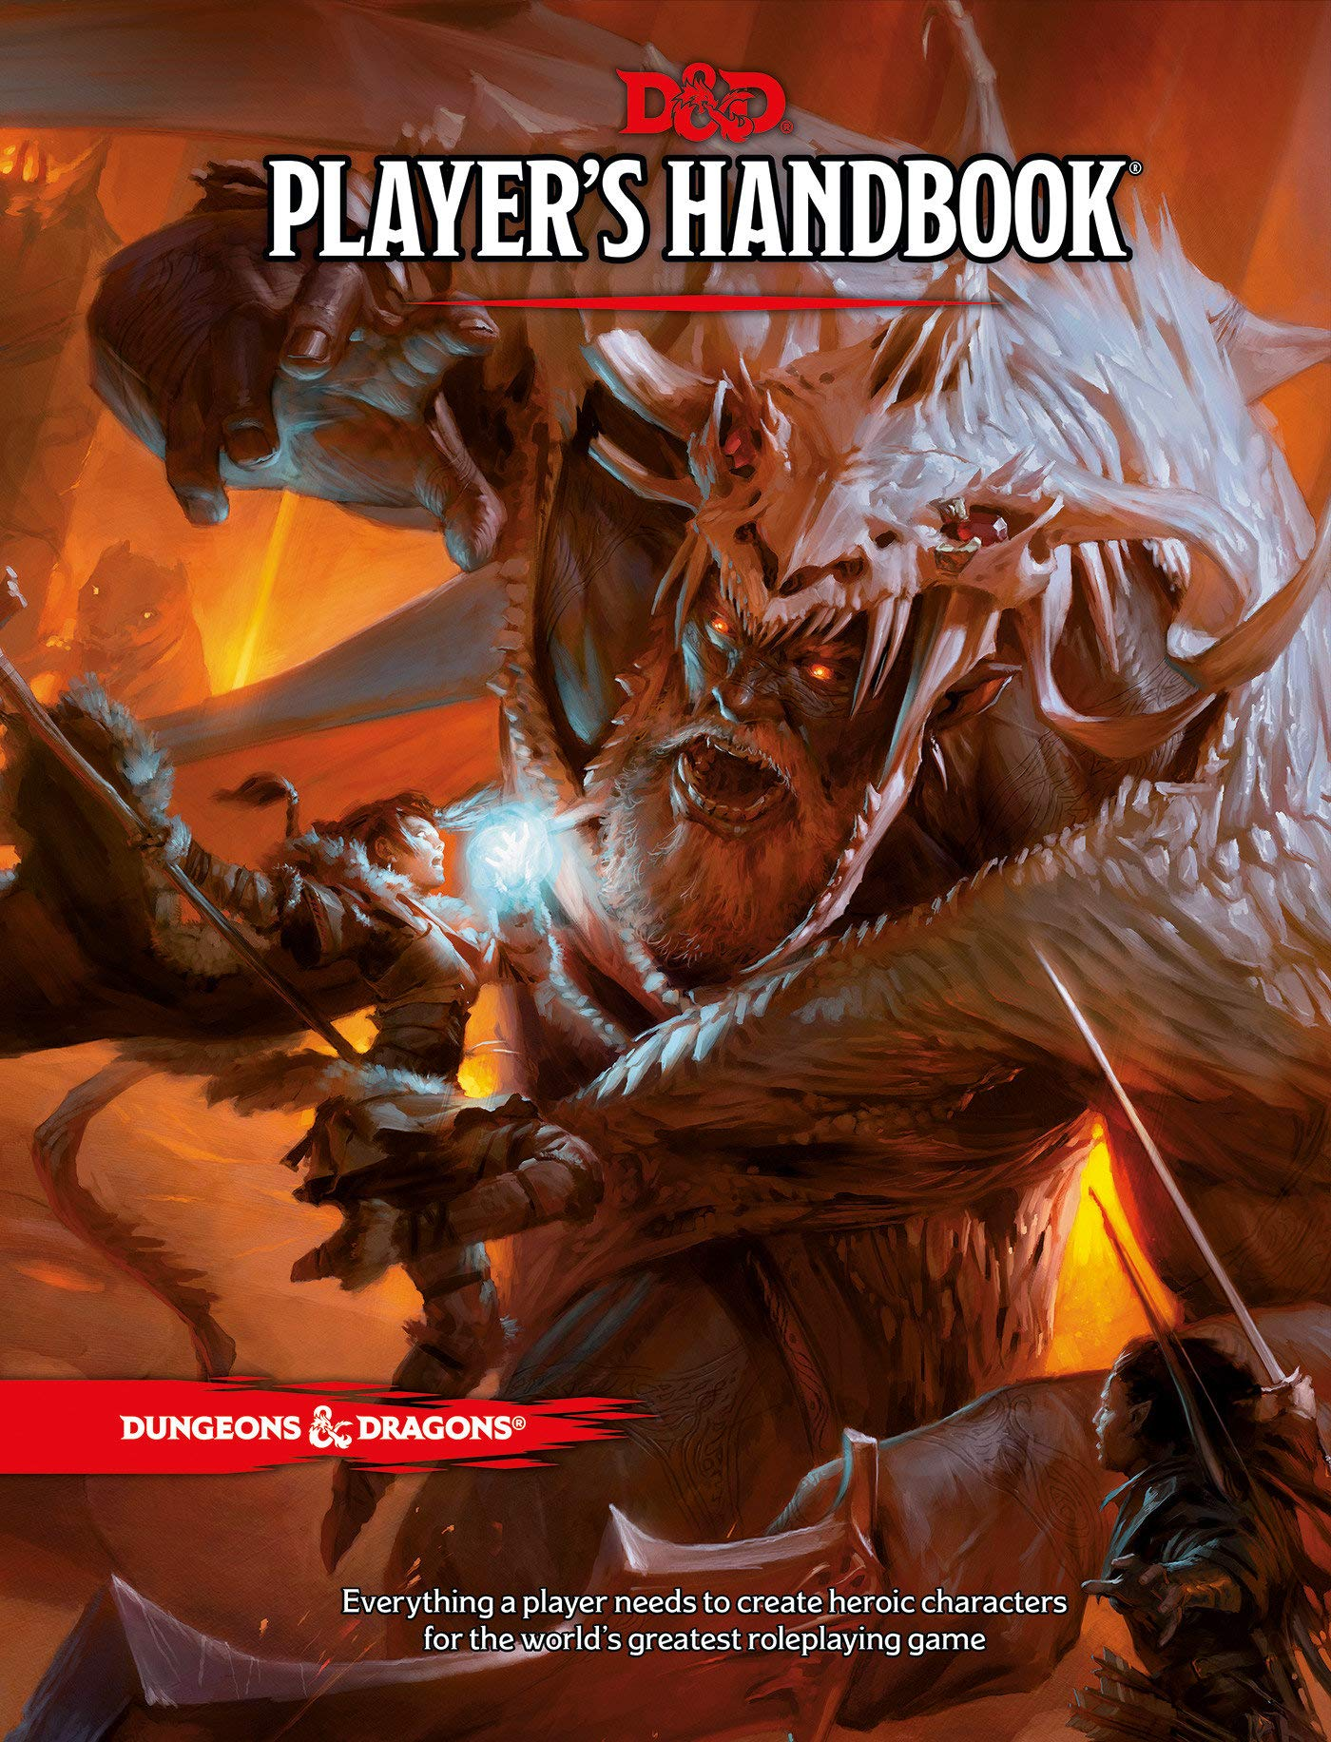
How do I play?
Dungeon/game master (DM/GM) and player characters (PCs)
Character creation
Gameplay

Slide 5
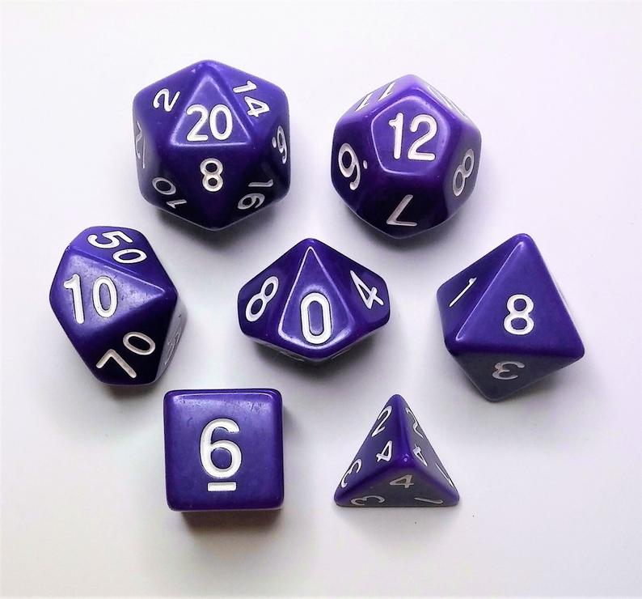
Gameplay:
Dice
A full set of standard D&D dice consists of 1 d20 (20-sided die), 1 d12, 2 d10 (percentile dice), 1 d8, 1 d6, and 1 d4
The most important one is the d20
Dice are rolled to, in combination with your character’s skills, decide the outcome of your actions

Slide 6
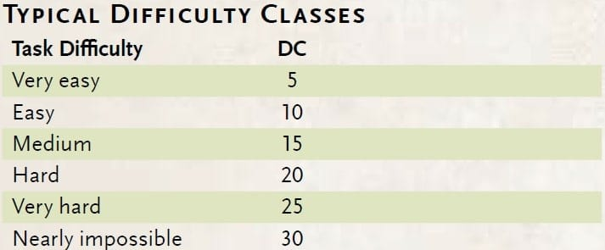
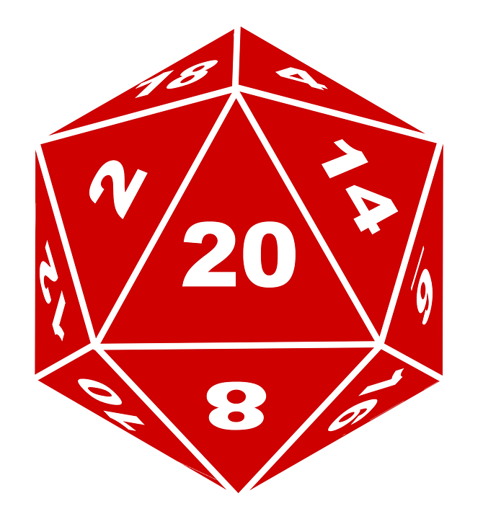
Gameplay:
Ability Checks
“I would like to…”
D20 roll
Skill modifiers
Natural 1s and 20s
Contested rolls

Slide 7
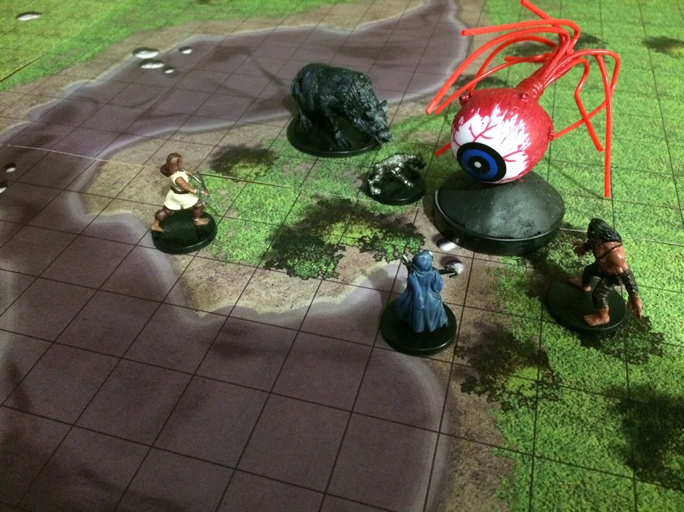
Gameplay:
Combat
Initiative: when your turn is
Movement speed: how far you can go
Hit points and damage rolls
Turn parts: movement, action, bonus action (and sometimes reaction)
Armor class (how hard you are to hit), attack rolls (how to hit other people), and saving throws

Slide 8
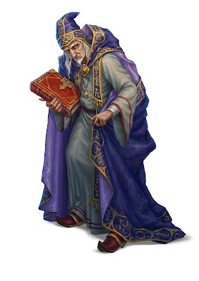
Gameplay:
Spellcasting
Not everyone casts spells! Other character types have other skills (with fewer rules)
Spell level, spell slots
Prepared casting vs. learned casting
Spellcasting ability, saving throws, spell save DC
Material components

Slide 9
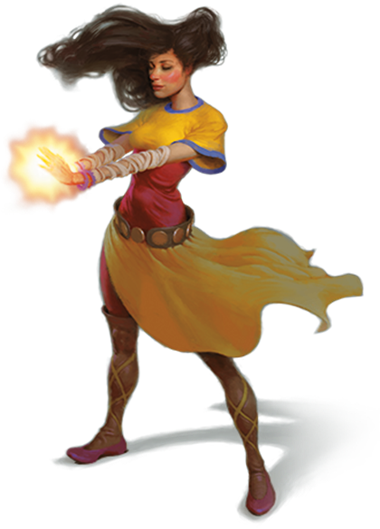
Character Creation:
Class
Core classes: Barbarian, Bard, Cleric, Druid, Fighter, Monk, Paladin, Ranger, Rogue, Sorcerer, Warlock, Wizard
Spellcasters and partial casters
Subclasses
Character level

Slide 10
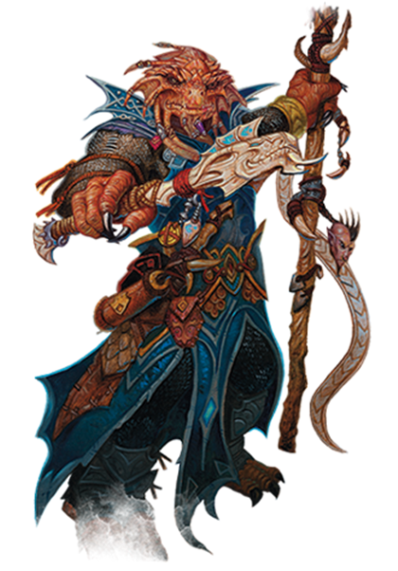
Character Creation:
Race
Core races: Dwarf, Elf, Halfling, Human, Dragonborn, Gnome, Half-Elf, Half-Orc, Tiefling
Subraces
Stat bumps, languages, proficiencies, abilities

Slide 11
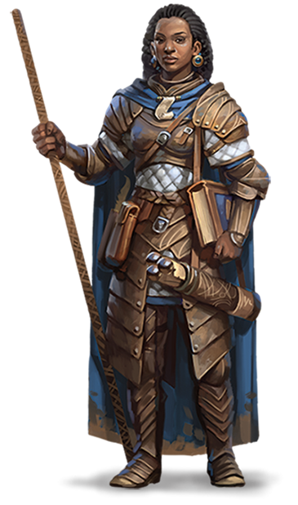
Character Creation:
Statistics
Core stats: Strength, Dexterity, Constitution, Intelligence, Wisdom, Charisma
On a scale from 1-20, with 10 being baseline and modifiers increasing on the even number, thus:
  Charisma score of 14 or 15 means a charisma modifier of +2
  Wisdom score of 4 or 5 means modifier of -3

Slide 12
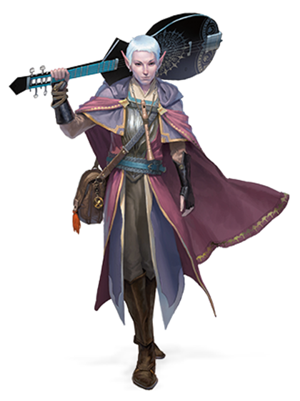
Character Creation:
Proficiencies
Skill proficiencies
  Proficiency bonus
Tool proficiencies
Language proficiencies
Armor and weapon proficiencies

Slide 13
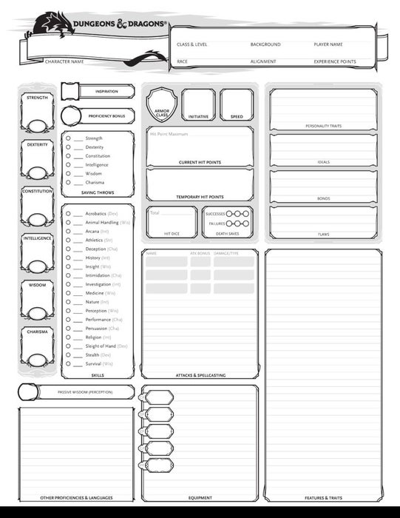
Character Creation:
Miscellaneous
Background
Alignment
Feats
Multiclassing

Slide 14
Also…
There’s no right way to play D&D!
Keep an open mind, ask questions, and always communicate about expectations.
In (most) D&D games, there’s not really such a thing as “winning.”

Slide 15
Further Resources
DnD Beyond (especially their new player guide)
Handbooker Helper videos by Critical Role
Rulebooks (at the library)
D&D podcasts and webseries
Me!

Slide 16
Thank You
Want a copy of this presentation?
Visit www.skokielibrary.info/handouts
where this presentation will be available
for four weeks.

