Slide 1
Dating Websites
Caitlin Myers
Information Services Supervisor
Notes:
Welcome to Dating Websites. Introduction sheet.

Slide 2
OBJECTIVES
Define algorithm in the context of dating websites
Discover the difference between a dating website and an app
Narrow down which website or app is right for you.
Search for online safety tips
Learn how to set up a good online dating profile

Slide 3

What is online dating?
http://blogionista.com/2016/06/the-virtual-cupid-is-online-dating-for-you/
Notes:
Online Dating: the practice of searching for a romantic or sexual partner on the Internet, typically via a dedicated website.

Slide 4
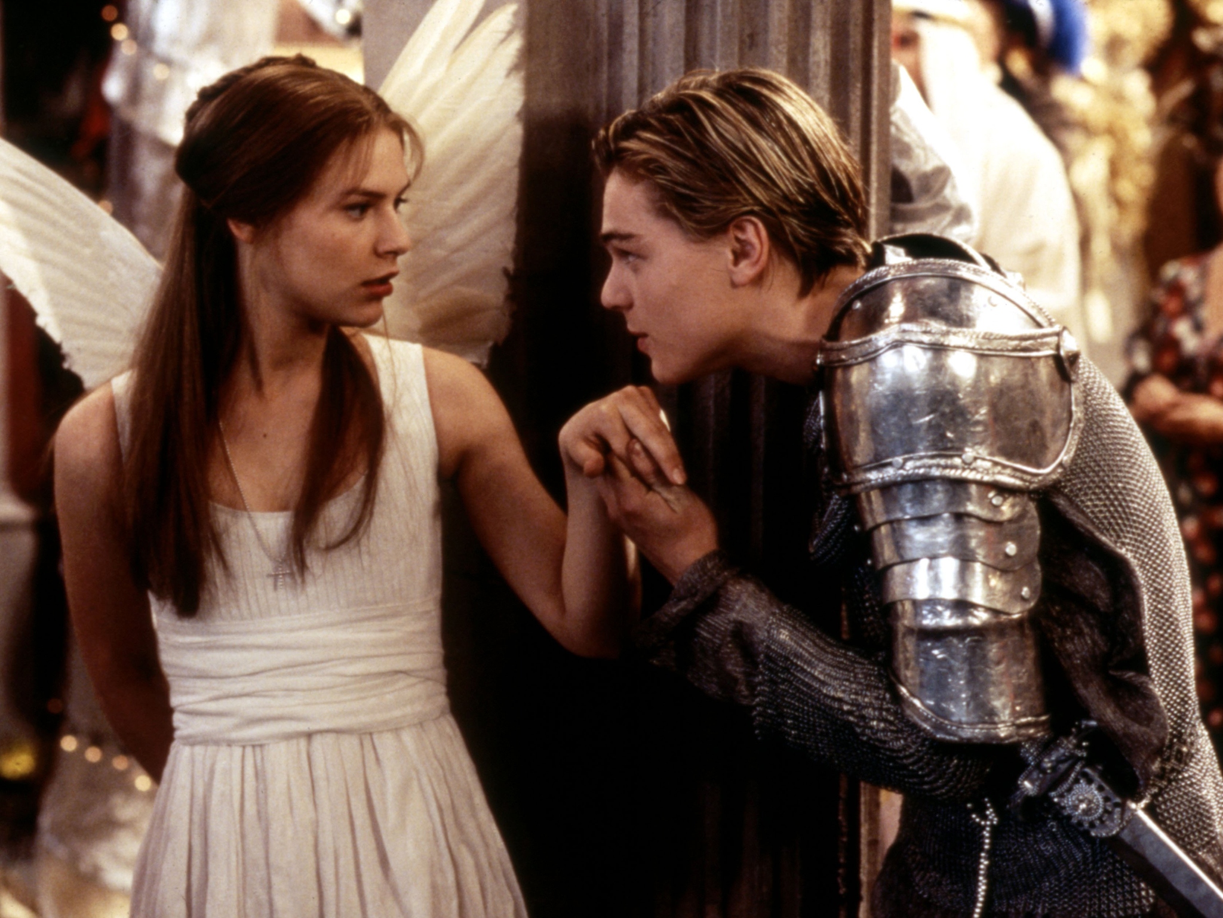
What’s in
an Algorithm?
https://static.independent.co.uk/s3fs-public/thumbnails/image/2015/03/04/13/Romeo-Juliet-Rex.jpg
Notes:
“A process or set of rules to be followed in calculations or other problem-solving operations, especially by a computer”-Oxford Dictionary

Slide 5









Common Dating Websites

Slide 6
Other Dating Apps
The League
Hinge
Bumble
Hily
Coffee Meets Bagel

Slide 7
Does it really matter which one I choose?
YES!

Slide 8
Building a Profile
What are you looking for in a partner?
Short term? Long term?
Habits?
Religion?
Politics?
Summary?

Slide 9
Best way to get matches?
A good profile picture
Phrases or “hooks”
Frequently use website
Get ideas from other profiles
Notes:
Picture: Smiling, laughing, having a good time
“Hooks”: specific key phrases like “reading” or “outdoors”
Frequency: The more you use the website, the more you will get out of it.
Ideas: See what other people/friends are putting on their profiles that make them successful.

Slide 10
The More You Know
Create a new email account. (Never give out your main email or phone number).
Never agree to buy someone gifts like a plane ticket to meet up.
Be wary of suspicious behavior (indicators of robots).
If you choose to pay for a premium account, explore various sites and options before you commit.
Be aware of catfishing.

Slide 11
Thank You
Want a copy of this presentation?
Visit www.skokielibrary.info/handouts
where this presentation will be available
for four weeks.

