Slide 1
Get Started with
Google Calendar
By Perry Nelson
Information Specialist

Slide 2
What is it?
Free calendar app
Cloud-based, saves and syncs automatically
Comes as a part of your Google account

Slide 3
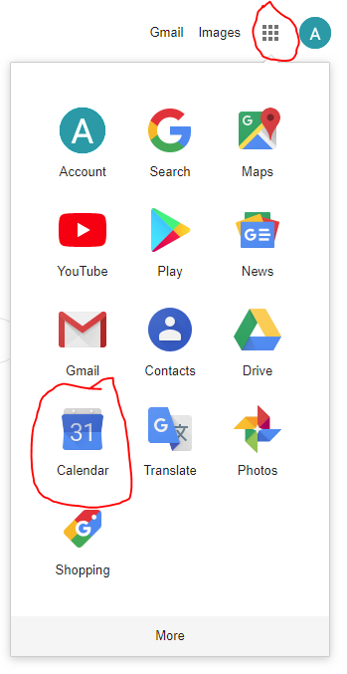
Where is it?
Phone app (which we won’t be using)
On your computer, go to calendar.google.com or google.com/calendar
Or click the nine boxes on the top right of any Google page and then select the calendar icon (see right):

Slide 4
Thank You
Want a copy of this presentation?
Visit www.skokielibrary.info/handouts
where this presentation will be available
for four weeks.

